Slide 1
JAVA

Slide 2
Core JAVA
Introduction to Java
Java Features
Java Editors
JDK installation
First java program
classes and objects
new keyword
javac and java commands
Constructor and Constructor Overloading
instance and static variables
instance and static methods

Slide 3
instance and static block
javap command
Data-types
Literals
Operators
Conditional statements
Loops
Enhanced for loop
Command line arguments
Wrapper classes
Keyword this
accessing instance variables and methods
invoking current class constructors of different argument

Slide 4
Difference between constructors and methods
Principles of OOPs
Encapsulation
Inheritance
Polymorphism
Abstraction
Encapsulation
Private fields
Setter methods
Getter methods
Inheritance
Types of inheritance
Constructor chain in inheritance

Slide 5
Keyword super
accessing super type variables and methods
invoking super type constructors of different argument
Method Overriding
Super type referencing the sub type objects
Polymorphism with method overloading and overriding
Abstraction
Interface
Marker Interface
Non Access modifiers like static, abstract and final
Abstract classes
Difference between abstract class and interface

Slide 6
Type Conversion
auto widening and explicit narrowing
auto upcasting and explicit downcasting
instance operator
Keyword final
For variables
For classes
For methods
Packages in Java
create user-defined package
importing the user-defined packages

Slide 7
Access specifier
private scope
package scope
protected scope
public scope
Scanner class
Exception Handling
Keyword try
Keyword catch
Keyword finally
Keyword throw
Keyword throws
Exception hierarchy

Slide 8
Checked and Unchecked exceptions
Handling all types of exceptions
Custom exception
Predefined packages
java.lang
java.io
java.util
Multithreading
Runnable interface
Thread class
start and run difference
Some common methods in Thread
Synchronization

Slide 9
Object class
String, StringBuffer and StringBuilder
Difference between these classes
Some useful methods
Math class
Runtime and Process class
Util Package Classes
Date
Stack
StringTokenizer
BitSet
Scanner etc.

Slide 10
Collection Framework
List
ArrayList
Vector
LinkedList
Set
HashSet
LinkedHashSet
TreeSet
Queue
PriorityQueue
Using Enumerator
Using Iterator

Slide 11
Map
HashTable
HashMap
LinkedHashMap
TreeMap
Generics
Advantages of generics over non genric Collection
Applying generics for Collection APT’s
Collection class
Static import
Enums
Var-args

Slide 12
Introduction to JAVA
What is JAVA?
JAVA is a Pure Object Oriented Programming Language developed by SunMicroSystems.
Java is a Platform (JRE and API).
Platform: It’s any hardware or software environment in which a program runs.

Slide 13
Introduction to JAVA (contd.)
Few
Languages
before
JAVA?
Machine Code
Assembly Language
C
Smalltalk
C++
Java

Slide 14
Introduction to JAVA (contd.)
History of JAVA
Java was developed by James Gosling, Patrick Naughton and Mike Sheridan.
It was initiated in 1991 and was called as Green.
It was initially developed in 1993 and was initially named Oak.
Finally in 1995 Java 1.0 was released.

Slide 15
Introduction to JAVA (contd.)
*7 : First project developed using Java (1993-mids)
HotJava : browser to advertise about Java (1995)
Netscape : gave Java it’s first break (1996)

Slide 16
Introduction to JAVA (contd.)
Why java is called as Pure OOP language?
Properties of OOP Language:
Encapsulation Abstraction
Inheritance Reusability
Polymorphism Overloading
Overriding
Everything must be written within class.
Everything must be created in terms of classes and objects.
Every actions must be performed by method invocations.
C++
JAVA
Smalltalk

Slide 17
JAVA Features
Simple
Pure OOP
Platform independent
Portable
Secure
Robust
Dynamic
Multi-threaded
Exception Handling
Distributed
Both compiled and interpreted

Slide 18
JAVA Editions
Java SE
Java EE
Java ME

Slide 19
JDK Installation
JDK stands for Java Development Kit. It is required to develop Java programs.
To install JDK follow these simple steps:
Download JDK
Install JDK and JRE
Include JDK’s “bin” Directory in the Path.
JDK’s “bin” Directory can be also used in “.bat” file.

Slide 20
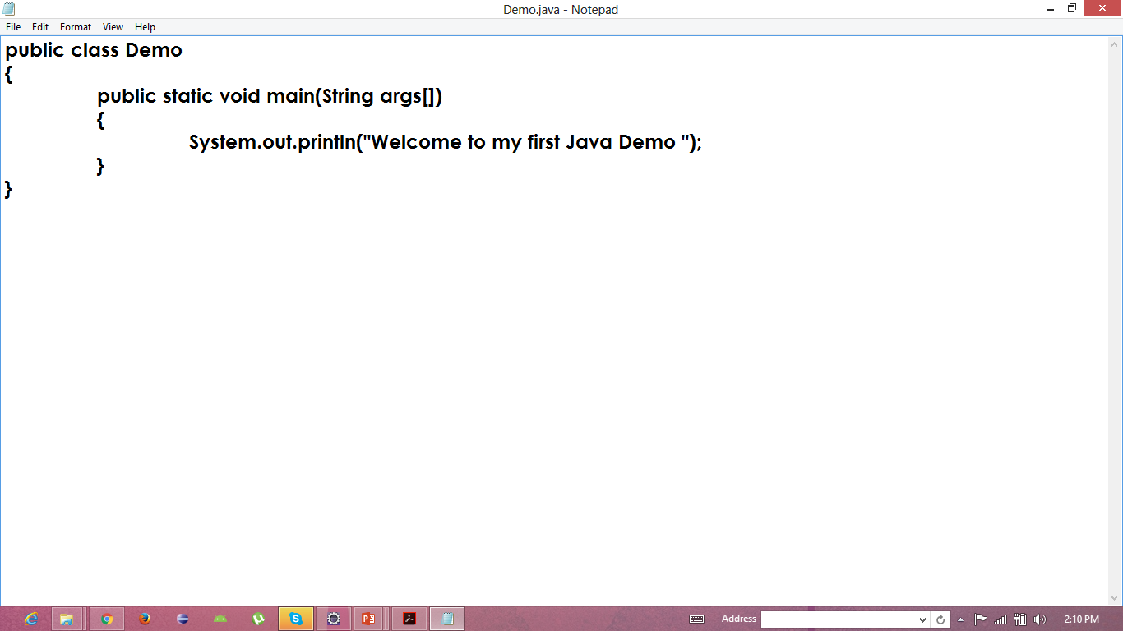
First Java Program

Slide 21
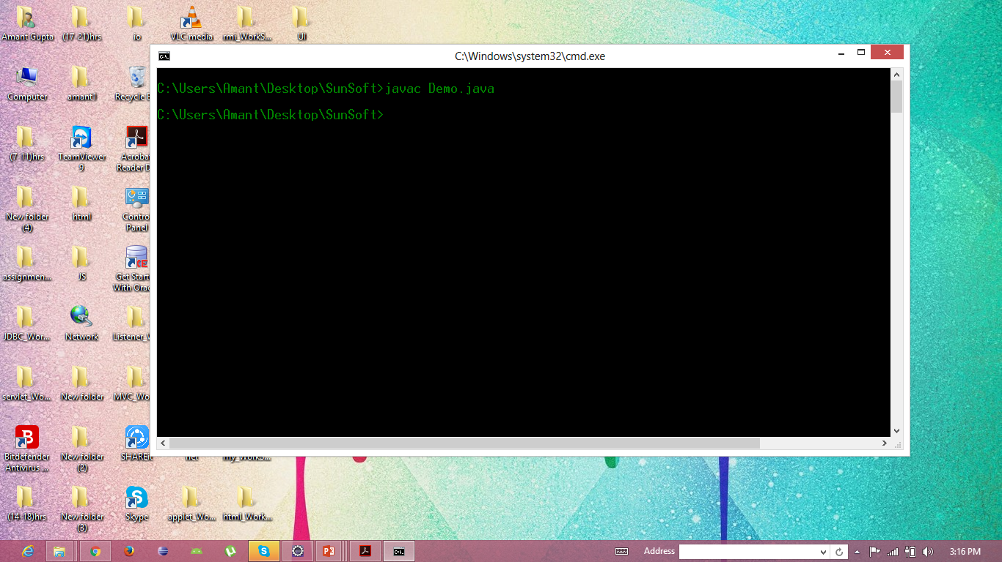
First Java Program (contd.)

Slide 22

First Java Program (contd.)

Slide 23

First Java Program Output

Slide 24
Setting the path
How to set path to execute a java program?
By setting the environment variable
By creating .bat file

Slide 25
Setting the path (contd.)
How to set the environment variable?
Right-click on ‘Computer’ icon.
Select ‘Properties’ option.
Click on the ‘Environment Variables’ button under the ‘Advanced’ tab.
Alter the ‘path’ variable.
You can also add a new variable.
Add ‘C:\Program Files\Java\jdk1.7.0\bin’ path to the existing path.
Provide a semicolon (;) after the default path.
Finally save it.

Slide 26
Setting the path (contd.)
How to create .bat file?
To create .bat file open notepad.
Then write “set path = PATH_OF_JDK-BIN then append ;.;%path%”
Then write “set classpath = .;%classpath%”
Finally write start.

Slide 27
Classes and Objects
Definitions:
Class is a blueprint or template of an object.
E.g.: blueprint of a building
Object is an instance of a class or any real world entity.
E.g.: building

Slide 28
Classes and Objects(contd.)
Class name and file name should be same if that class is ‘public’.
We can’t create more than one public class in a same file.
‘.java’ file is not converted to ‘.class’
‘.class’ file is made of every class regardless of ‘main method’ and ‘public class’.
We can create more than one ‘main method’ in a single file.
We can execute only that class which has ‘main method’.
It’s a good practice to keep the main method in the class which has ‘business logic’.

Slide 29
Classes and Objects (contd.)
Naming convention in Java (CamelCase)
Noun | ClassName
Verb | methodName
Entity | variable

Slide 30
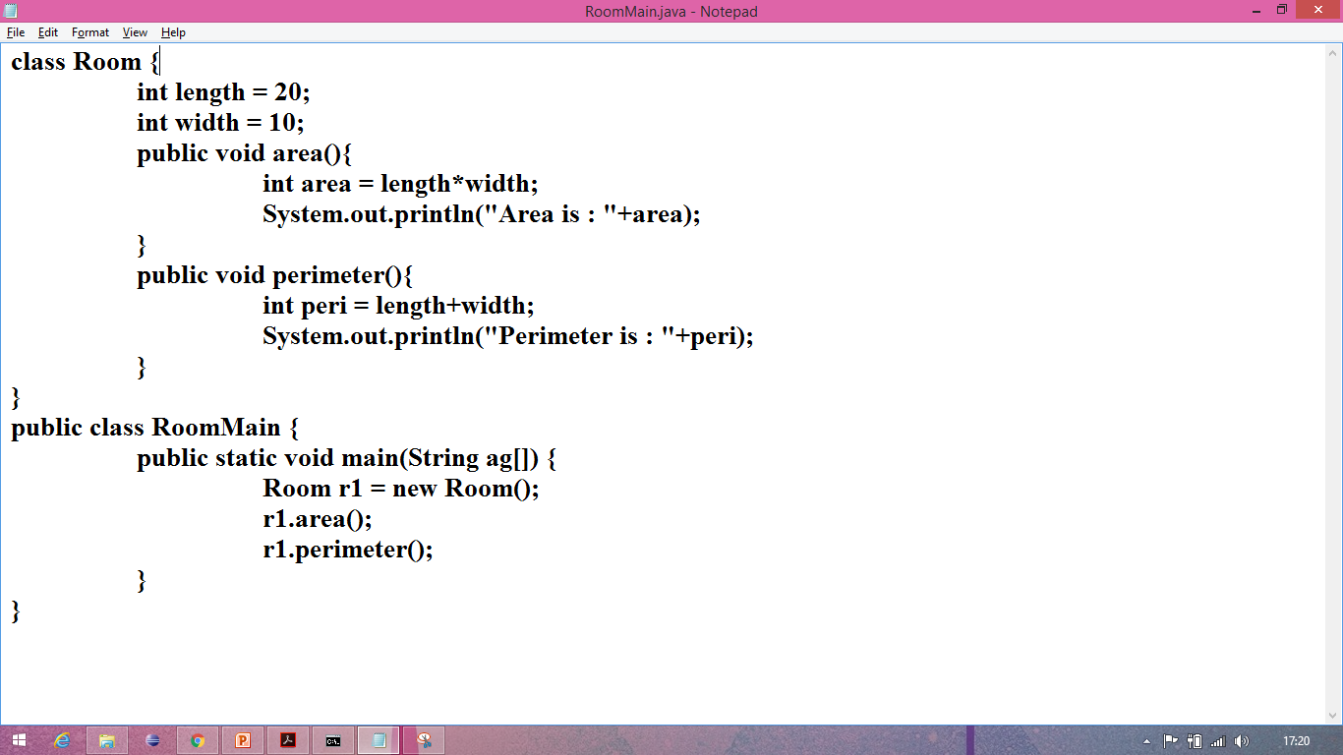
‘new’ keyword
‘new’ keyword creates the object of a class.
‘new’ keyword assigns memory when any object is created.

Slide 31
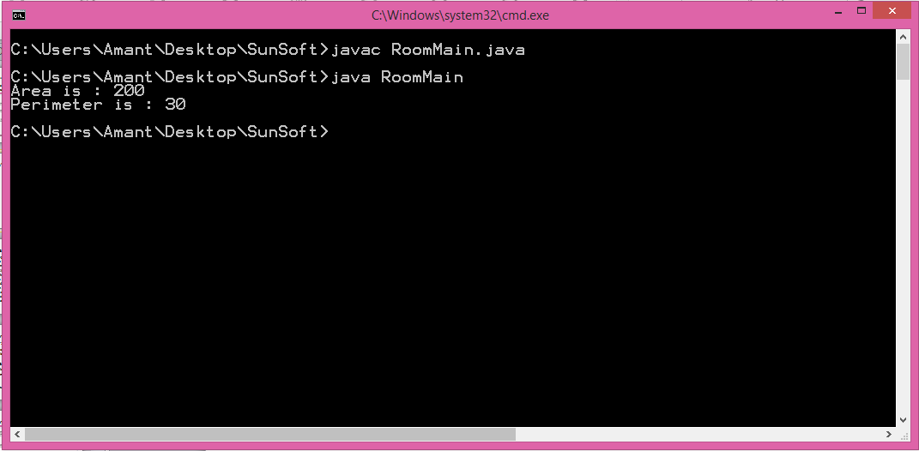
‘new’ keyword (contd.)

Slide 32
javac and java command
javac is a component of JDK.
It is used to compile the program i.e. it checks the syntactical errors and converts source code into byte code.
java is a component of JDK as well as JRE.
It is used to run the “.class’ file i.e. it converts byte code into machine code.

Slide 33
Constructors and overloading constructors
Constructors are a kind of special method.
Constructors must have the same name as the class itself whereas methods can have any name including the class name.
There is no need of calling constructors, unlike methods constructors are automatically called when we create object of the class.
We can invoke methods ‘n’ number of times but constructors can be invoked only once i.e. during the creation of object.
We can put any logic in constructors alike methods.
Return type can’t be used with constructors.
If return type(s) are used with constructors then it behaves like method.
Non-access modifiers can’t be used with constructors.

Slide 34
Constructors and overloading constructors (contd.)
Default Constructor:
Default constructor is provided by compiler, which is always empty and if any constructor is declared explicitly then no default constructor is provided.
Constructor Overloading:
Constructor overloading is the phenomenon of creating more than one constructor with same name but with different parameter list in the same class.
We can’t override a constructor where method overriding is possible.

Slide 35
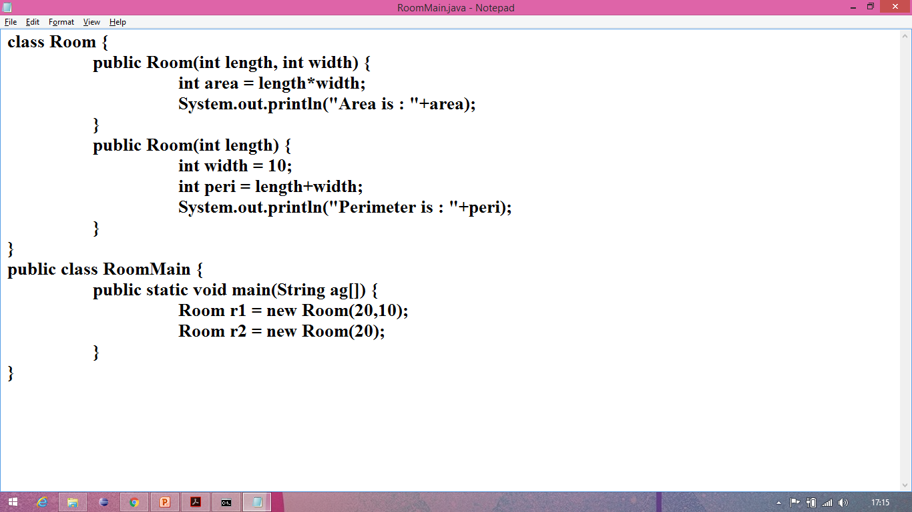
Constructors and overloading constructors (contd.)

Slide 36
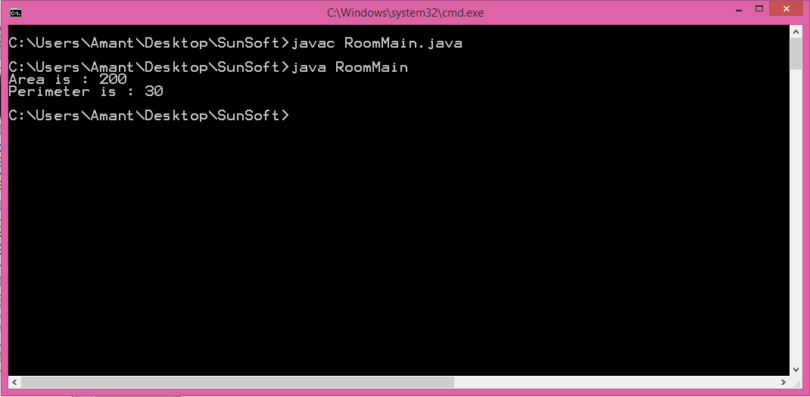
Constructors and overloading constructors (contd.)

Slide 37
instance and static variables
instance variables:
Instance variables are declared inside a class but outside any block like methods or constructors.
Instance variables are created when an object is created and destroys when the object is destroyed.
Instance variables are stored in heap memory.
The scope of instance variables is throughout the class.
Instance variables can be directly invoked by calling the variable name.
Default values of instance variables:
int ‘0’
boolean ‘false’
String ‘null’

Slide 38
instance and static variables (contd.)
static variables:
Static variables are also called as ‘Class variables’.
Static variables are declared inside a class with ‘static’ keyword, but outside any block like methods or constructor.
Static variables have only one copy throughout the class regardless of number of object created.
Static variables are stored in static memory.
It is mostly used to declare constants.
Default values of static variables are same as instance variables.
Static variables can be invoked by calling the class name.
ClassName.variable_name

Slide 39
instance and static methods
instance methods:
Instance methods are declared normally i.e. without static keyword.
Instance methods belong to the object of the class.
Instance methods can be called after creating the object of the class.
Instance methods are stored in permanent generation of heap memory but their parameters and their local variables and value to be returned are stored in stack.
Instance methods can be overridden.

Slide 40
instance and static methods (contd.)
static methods:
Static methods belongs to class.
Static methods are declared by using static keyword.
Just like static variables, only one copy of static method is passed throughout the class regardless of number of object created.
Static methods are stored in permanent generation of heap memory.
Static methods can be overloaded but cannot be overridden.
Static methods can be invoked by calling the class name.
ClassName.methodName()
Static methods can’t access instance methods and instance variables directly but instance method can access static variables and static methods directly.

Slide 41
instance and static block
instance block:
Instance block is executed when the instance of the class is created.
Instance block executes after the execution of static block.
‘this’ keyword can be used with instance block.
Both static and non-static variables can be accessed inside instance block.
Instance blocks are basically used for initializing instance variables or calling any instance method.

Slide 42
instance and static block (contd.)
static block:
Static block is executed when the class is loaded.
Static block executes before instance block.
‘this’ keyword cannot be used inside static block.
Static blocks are basically used for initializing static variables or calling any static method.

Slide 43
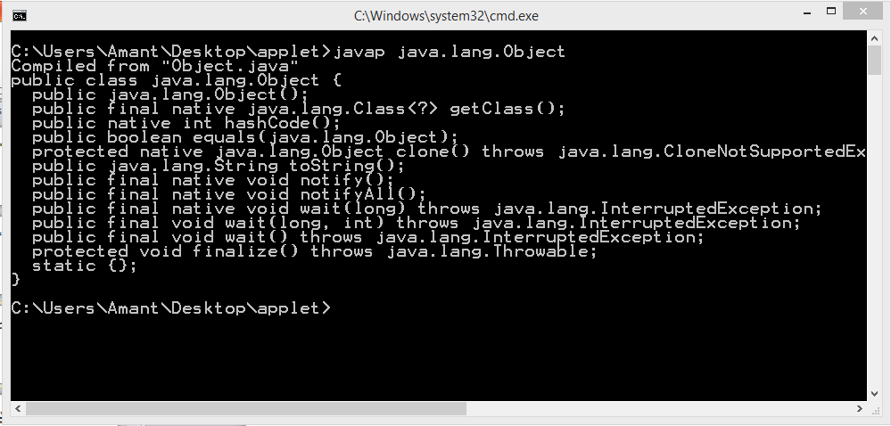
Javap command
javap command is used to see the properties of a class. It displays information about the fields, constructors and methods present in a class file.

Slide 44
Data-types
Data-types are the keyword which defines what type of value a variable may hold.
There is no ‘unsigned’ keyword in java.
There is no ‘short int’ or ‘long int’ in java.

Slide 45
Data-types
Primitive
Non-Primitive
Classes
Arrays
Interfaces
Enum, etc.
Numeric
Non-Numeric
boolean
char
Integer
Real
byte
int
short
long
float
double

Slide 46
Literals
A literal is a source code representation of a fixed value. They are represented directly in the code without any computation.
Literals can be assigned to any primitive type variable.
E.g.: int a = 10;
Prefix ‘0’ is used to indicate octal, and prefix ‘0x’ indicates hexadecimal when using these number systems of literals.
E.g.: int decimal=10;
int octal=014;
int hexa=0x10;

Slide 47
Operators
Variables: Variables are entities to hold some value.
Constants: Constants are something that cannot be changed.
Identifier: Identifiers are the name given to any variable, class or method.
‘$’, ‘_’ are allowed and can be used in the beginning of any identifier’s name.
Operators: Operators are any special character which performs operations on operands.
Operands: Operands are anything on which operator operates.

Slide 48
Types of Operators
Operators
Unary
Binary
Ternary

Slide 49
Types of Operators (contd.)
Arithmetic Operators: + - * / %
Logical Operators: && || !
Relational/Comparison Operators: == != > < >= <==
Bitwise Operators: & | ^ !
Shift Operators: >> << >>>
Conditional/Ternary/Tertiary/Question-mark Operator: int res=(a>b)?a:b;
Assignment/Short-hand Operators: = += == *= /= %=
Dot Operator: .
Increment/Decrement Operators:
Pre-increment ++
Post-increment ++
Pre-decrement --
Post-decrement --

Slide 50
Conditionals statements
In Java we have four types of conditional statements:
if statement
if-else statement
if-else if statement
switch statement

Slide 51
Conditionals statements (contd.)
if statement:
if statement is used if we want to execute a block of code if the condition is true.
Syntax:
if(condition)
{
block to be executed if the condition is true }

Slide 52
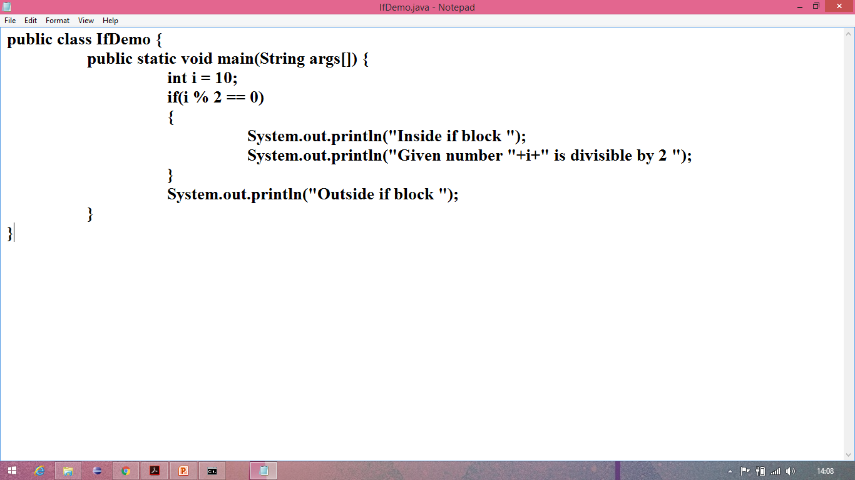
Conditionals statements (contd.)
if statement demo:

Slide 53
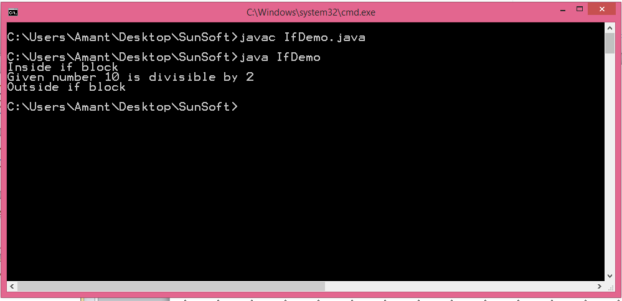
Conditionals statements (contd.)
if statement demo:

Slide 54
Conditionals statements (contd.)
if else statement: if else statement is used if we want to execute a block of code if the condition is true otherwise else block is executed.
Syntax:
if(condition)
{
block to be executed if the condition is true }
else {
block to be executed if the condition is false }

Slide 55
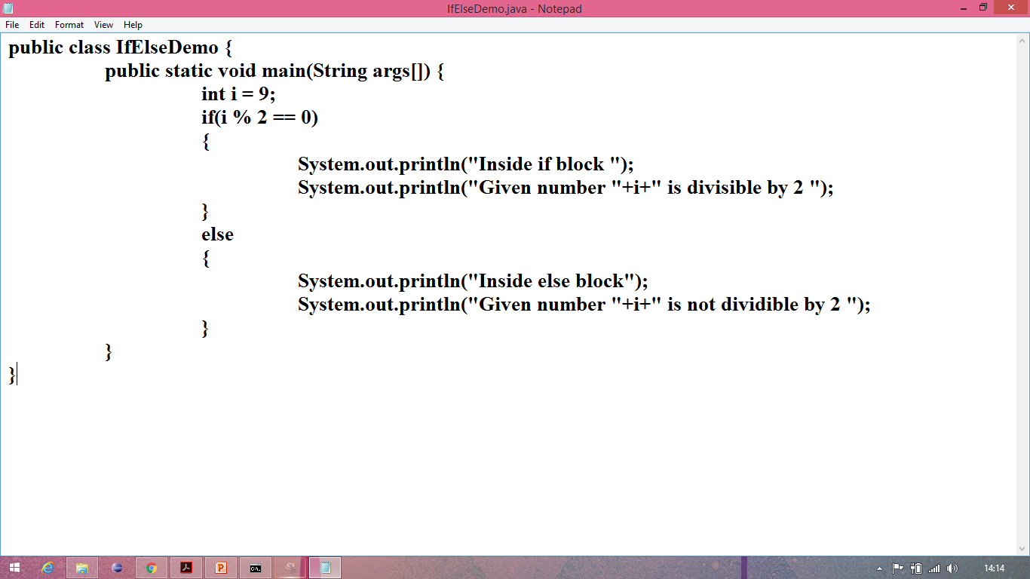
Conditionals statements (contd.)
if else statement demo:

Slide 56
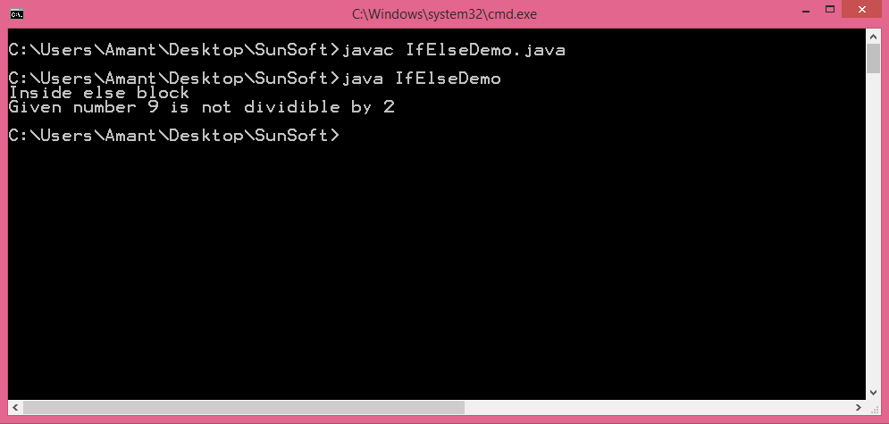
Conditionals statements (contd.)
if else statement demo:

Slide 57
Conditionals statements (contd.)
if-else if statement: if-else if can be used when we have to check multiple conditions. Syntax:
if(condition)
{
block to be executed if this condition is true }
else if(condition) {
block to be executed if this condition is true }
else { block to be executed if all the conditions are false }

Slide 58
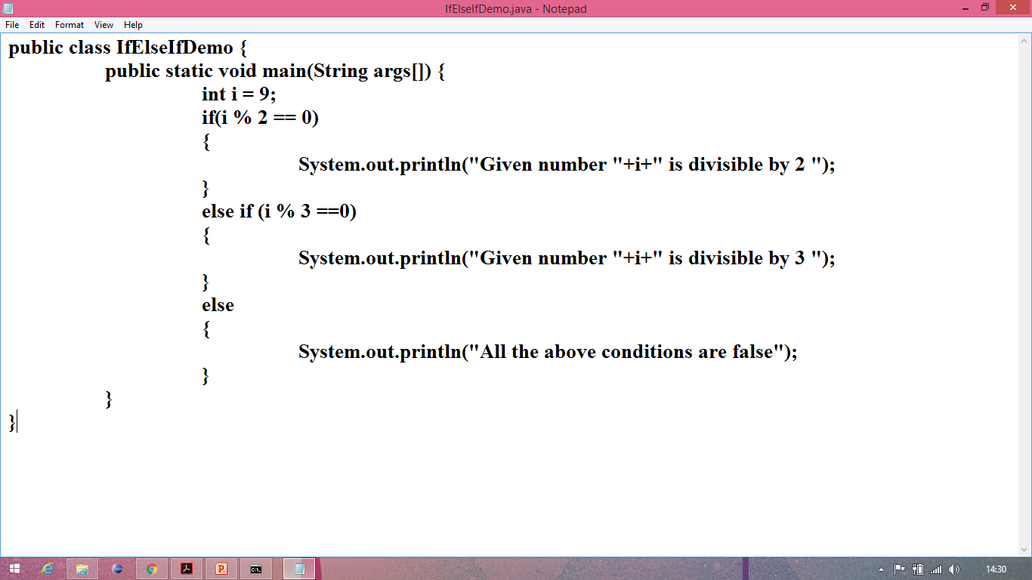
Conditionals statements (contd.)
if-else if statement demo:

Slide 59
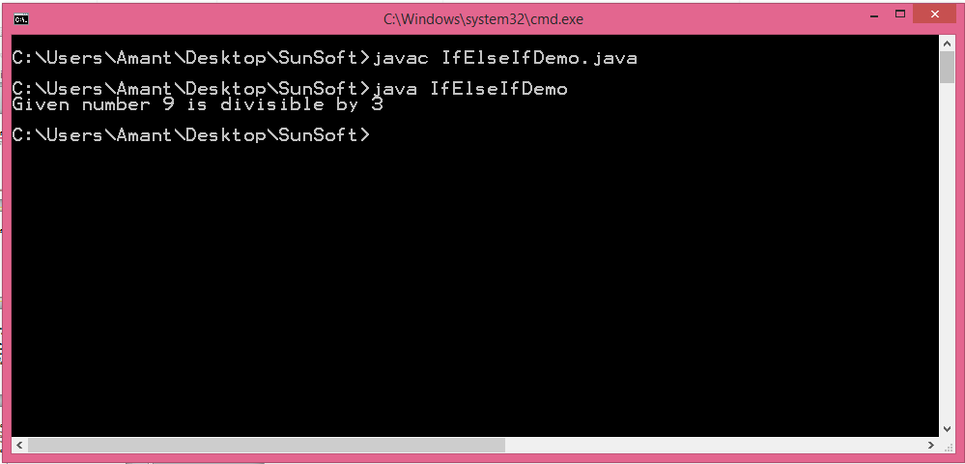
Conditionals statements (contd.)
if-else if statement demo:

Slide 60
Conditionals statements (contd.)
switch statement: switch statements can be used when we have to check multiple conditions and execute any one according to user’s choice.
Syntax: switch(choice) {
case 1:{ statements
}
case 2:{ statements
}
default :{
statements }}

Slide 61
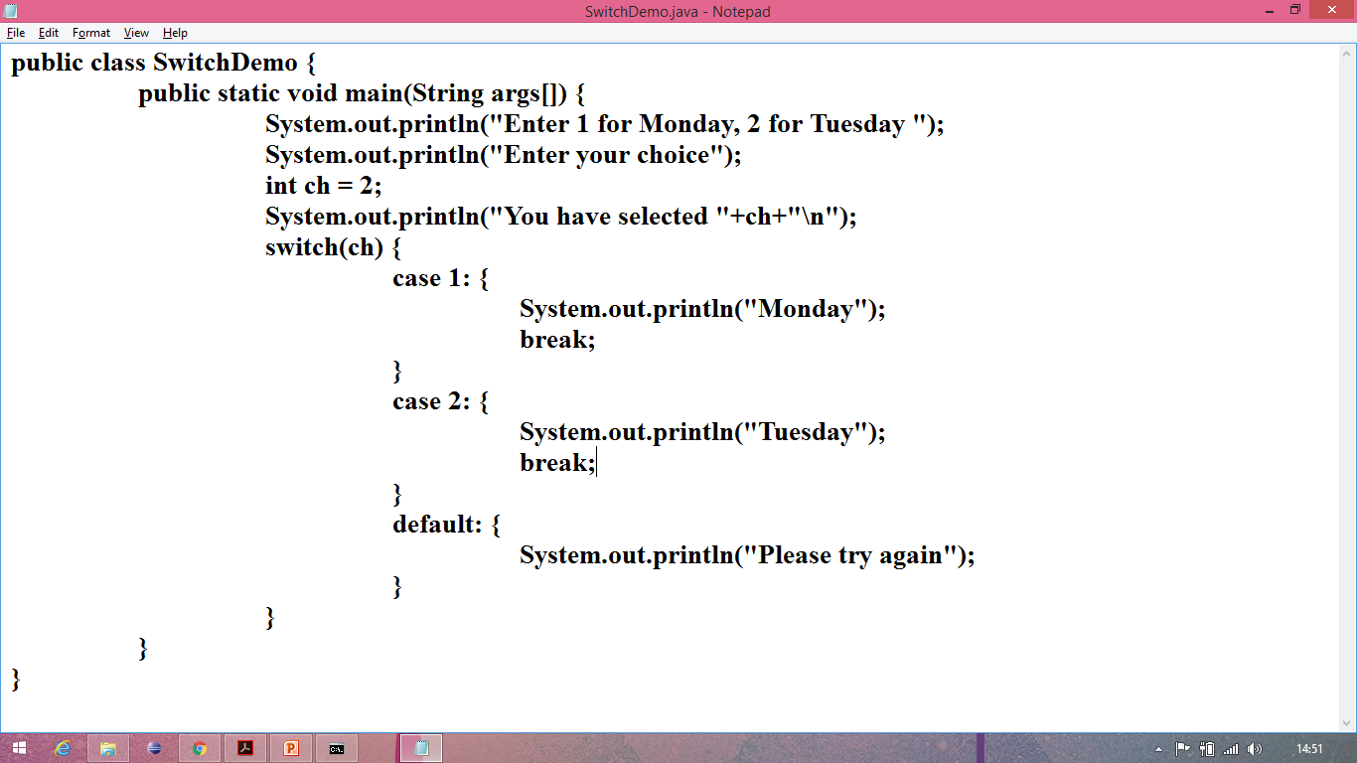
Conditionals statements (contd.)
switch statement demo:

Slide 62
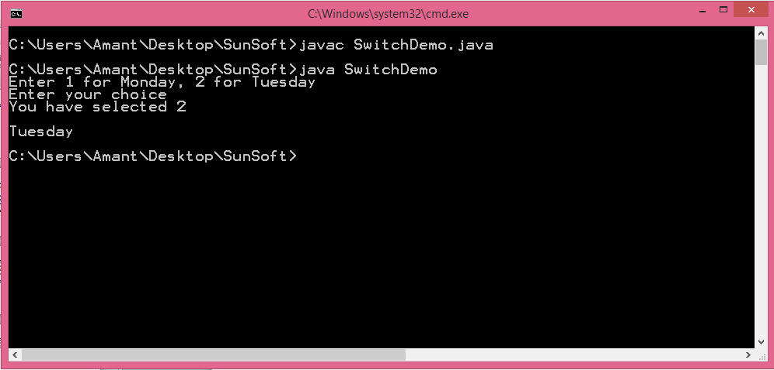
Conditionals statements (contd.)
switch statement demo:

Slide 63
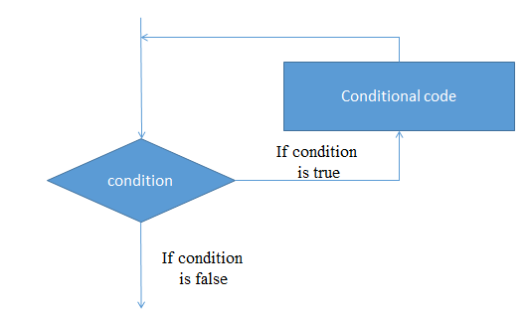
Loops
Looping statements are used to execute a block of code more than one time depending upon the scenario.
In java there are four types of looping statements:
while loop
do while loop
for loop
nested for loop

Slide 64
Loops (contd.)
while loop:
while loop is used to iterate a part of the program several times.
If the number of iteration is not fixed, it is recommended to use while loop.
Syntax:
while (condition)
{
block of code to be executed
expression }

Slide 65
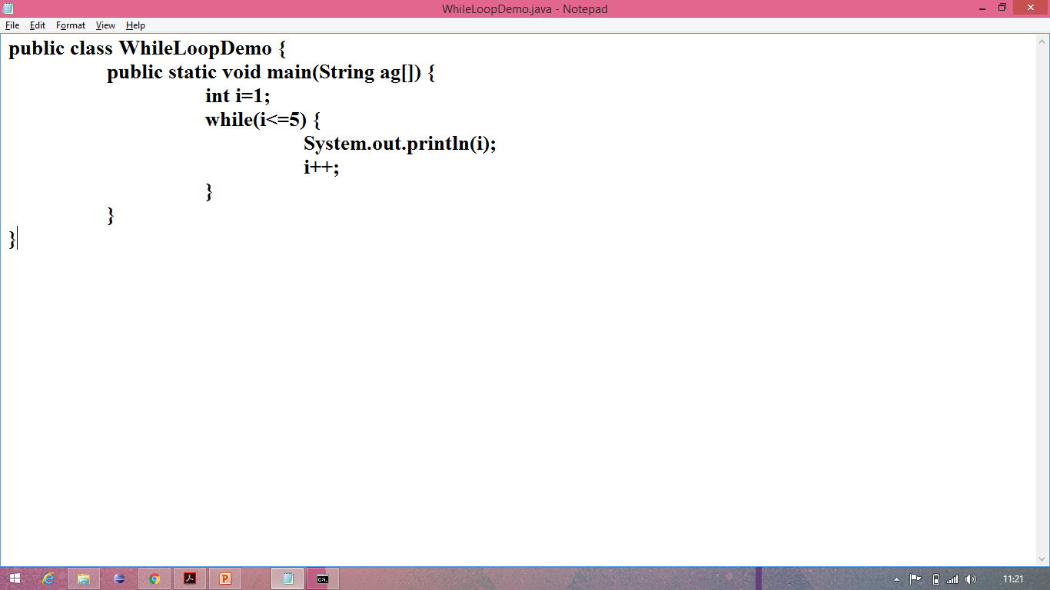
Loops (contd.)
while loop example:

Slide 66
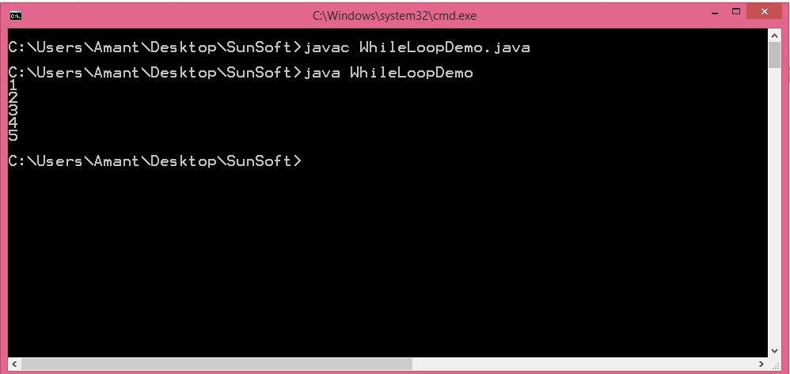
Loops (contd.)
while loop example:

Slide 67
Loops (contd.)
do while loop:
do while loop is used to iterate a part of the program several times.
If the number of iteration is not fixed and you must have to execute the loop at least once then it is recommended to use do while loop.
Syntax:
do {
block of code to be executed
expression } while (condition);

Slide 68
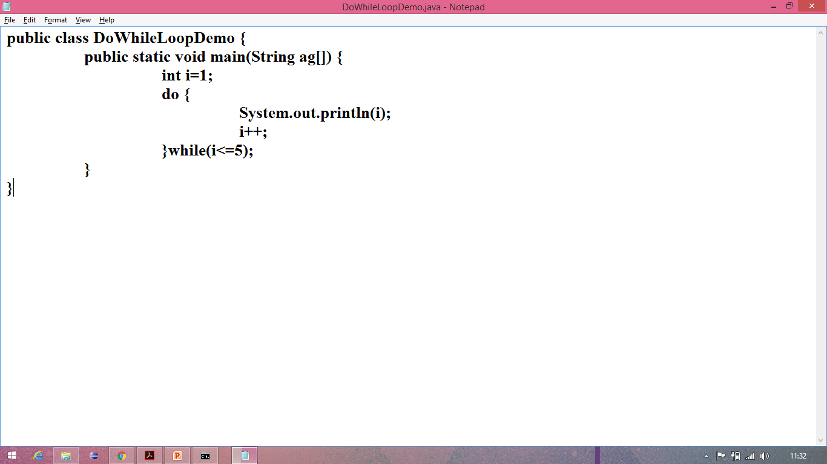
Loops (contd.)
do while loop example:

Slide 69
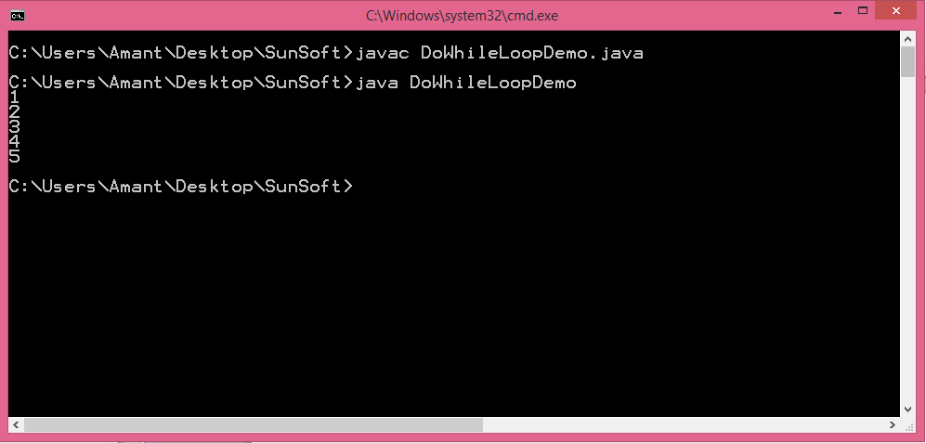
Loops (contd.)
do while loop example:

Slide 70
Loops (contd.)
for loop:
for loop is used to iterate a part of the program several times.
If the number of iteration is fixed then it is recommended to use do while loop.
Syntax:
for(initialization; condition; expression) {
block of code to be executed }

Slide 71
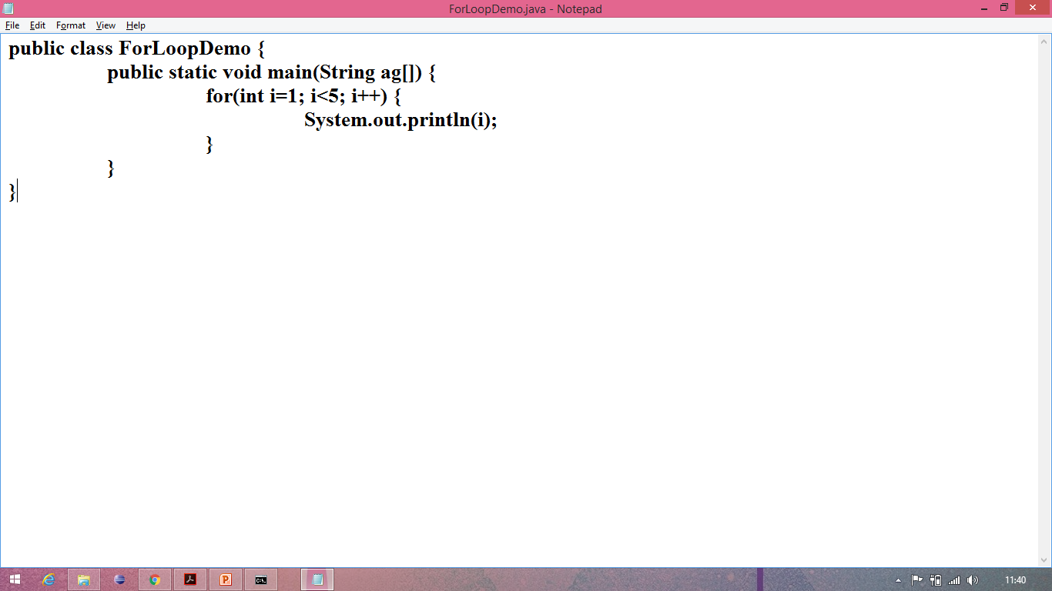
Loops (contd.)
for loop example:

Slide 72
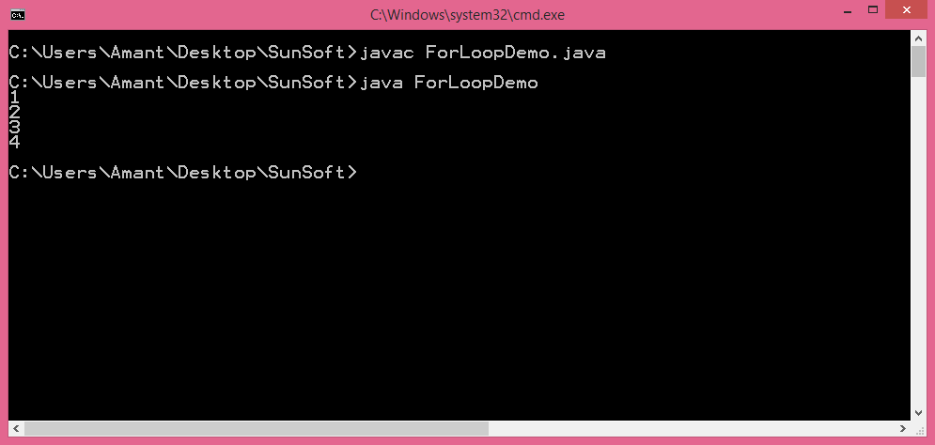
Loops (contd.)
for loop example:

Slide 73
Enhanced for loop
Enhanced for loop is used to traverse collection of elements including arrays.
Enhanced for loop was introduced in Java 5.
Syntax:
for(declaration : expression) {
block of code to be executed
}

Slide 74
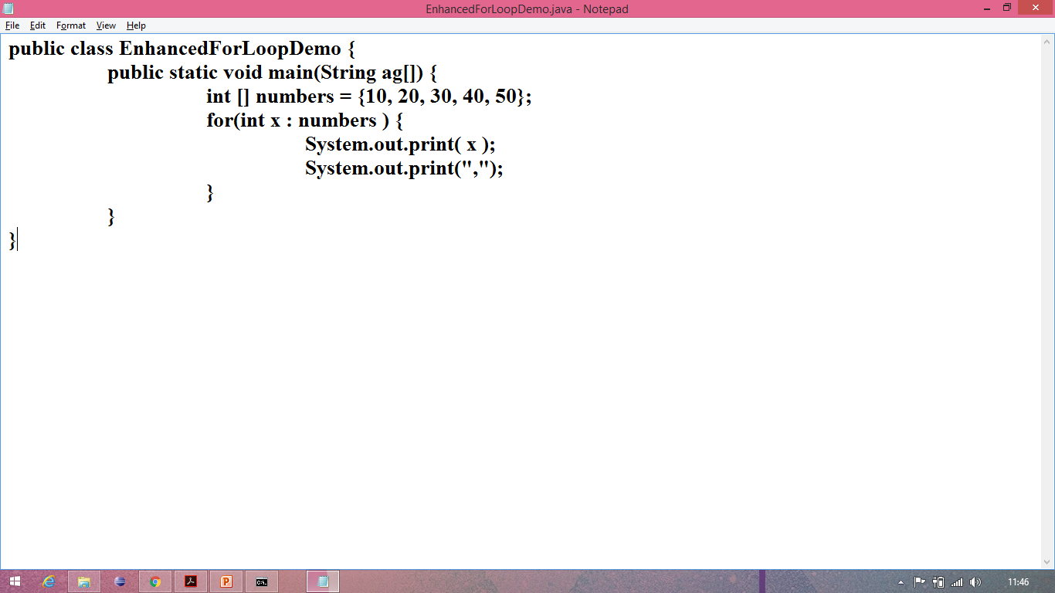
Enhanced for loop (contd.)
Enhanced for loop example:

Slide 75
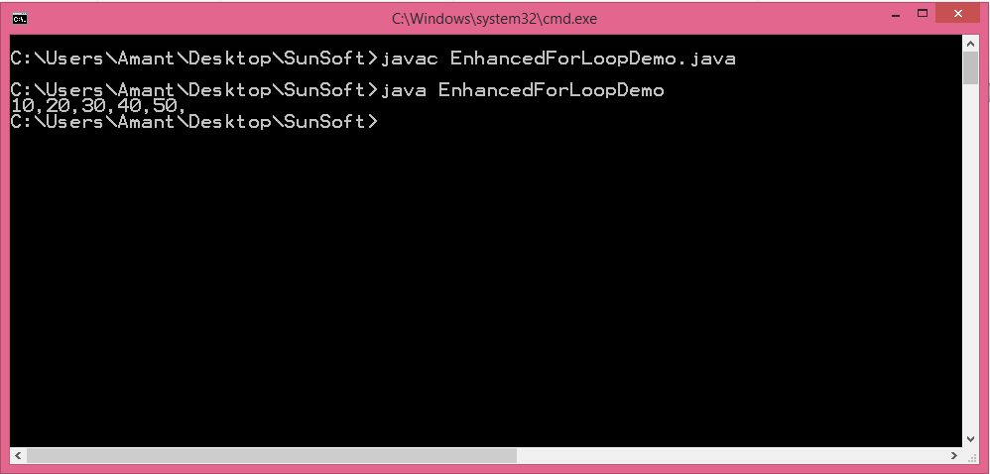
Enhanced for loop (contd.)
Enhanced for loop example:

Slide 76
Command line arguments
The command line argument is the argument passed to a program at the time when you run it.
To access the command-line argument inside a java program is quite easy, they are stored as string in String array passed to the args parameter of main() method.
public static void main(String args[])

Slide 77
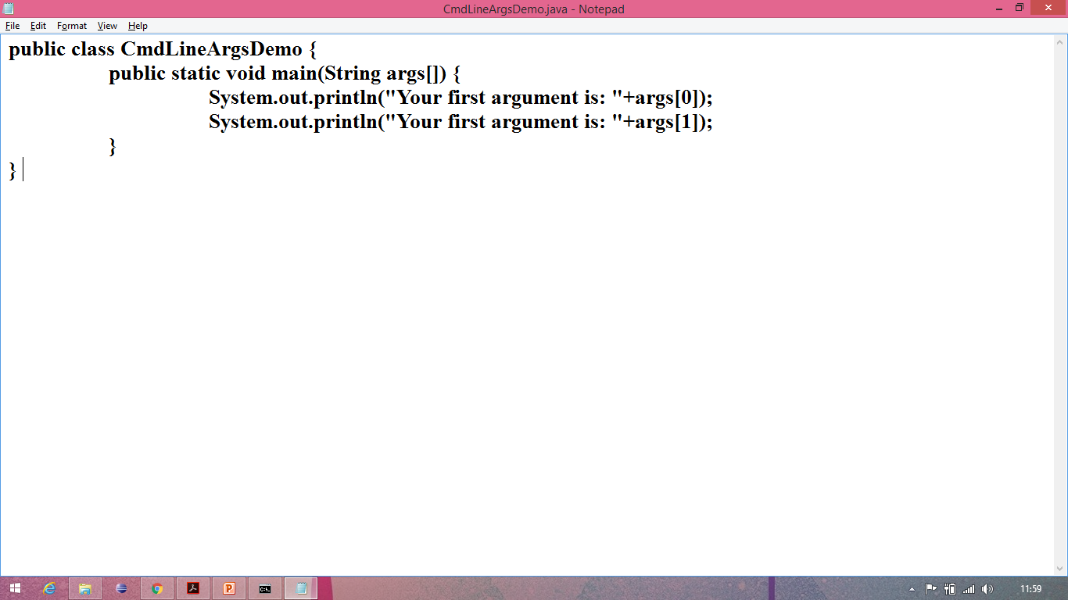
Command line arguments (contd.)
Command line arguments example:

Slide 78
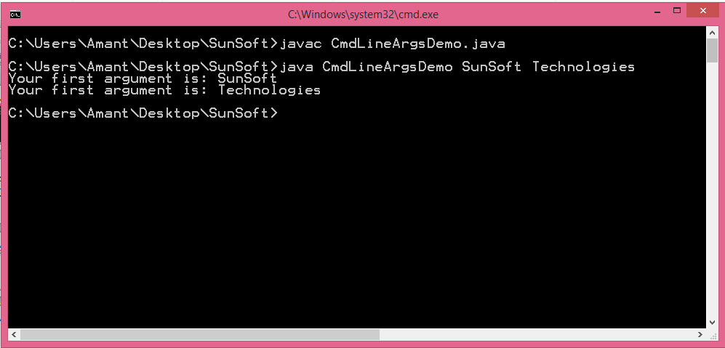
Command line arguments (contd.)
Command line arguments example:

Slide 79
Wrapper classes
Wrapper class was introduced in Java 5.
Wrapper classes | Primitive types
Byte | byte
Integer | int
Short | short
Long | long
Float | float
Double | double
Character | char
Boolean | boolean

Slide 80
Wrapper classes (contd.)
Unboxing:
The phenomenon of converting object into primitive is called unboxing.
E.g.:
Integer n=new Integer(5);
int n1=n.intValue(); //converting Integer to int (unboxing)
Autoboxing:
The phenomenon of converting primitive into object is called autoboxing.
E.g.:
int n=20;
Integer n1=Integer.valueOf(n);//converting int into Integer (autoboxing)

Slide 81
Keyword ‘this’
‘this’ is a keyword which refer to the same class or current class.
While calling constructor using this key word ,this keyword should be the first statement.
While calling variable and methods it can be any where.

Slide 82
Example for this key word
Demo :
class A
{
int a=34;
void add(){}
}
class B extends A
{
int a=22; System.out.println(this.a);
}

Slide 83
Difference between constructors and methods
constructors
methods
Constructors must have the same name as the class name.
Non access modifiers can’t be applied with constructors.
Constructors are automatically called when the object of the class is created.
Constructors can be called only once for one object.
Constructors don’t have any return type.
Constructs can’t be overridden.
Methods can be have any name including the class name.
Non access modifiers can be applied with methods.
Methods are needed to be called explicitly.
Methods can be called any number of times.
Methods have return type.
Methods can be overridden.

Slide 84
OOPS CONCEPT
There are 2 famous programming models
1. pops
2.oops
1.Procedure oriented programming model
The main building blocks of this model is function
Any function can access any data
Programming is more complex

Slide 85
2.Object oriented programming model
The main building blocks of this model is Object
Programming is more simple
Concept of encapsulation and data security code reusability
adding more function is not difficult
Objects are independent of each other

Slide 86
Difference between oops and pops
oops
pops
Object are main building blocks
Modification is easy because Object are independent of each other
It provide access modifier so more secure
Ex: c language
Function are main building block
Modification is difficult because functions are dependent on each other
It is not provide any access modifier so less secure
Ex : java and c++

Slide 87
Principle of oops
There are total six oops concept
Encapsulation
Inheritance
Polymorphism
State and behaviour should be declare inside the class
Every thing should be in terms of classes and Objects
Every operation should be done by invoking method

Slide 88
Java is not 100% Object Oriented Programing language
Java supports only first 4 features of oops so Java is pure Object oriented Programming language
Small talk support all feature of oops so it is 100% oops
C++ support first 3 feature of oops so it is object oriented programming language
C does not support oops

Slide 89
Encapsulation
In Encapsulation the data and function are declare inside class itself.
Abstraction is concept of data hiding and is part of encapsulation
ex :class, capsule
class {
int a=10;
void add(){
}
}

Slide 90
a . private fields
We can create pure Encapsulation class by declaring all data as private
setter method
Is used to access and set the value of private data in other class
getter method
It is used to allow other class to access the private data

Slide 91
Differences between java bean class and normal class
java bean class
Normal class
java bean class must be declare as public
All instance variable must be declare as private
getter and setter is used to access the data
It should have default constructor only
Normal class can be public or default
variable can have any access modifier
Depending upon access modifier we can access the data
Any constructor is allowed

Slide 92
Inheritance
It is used to inherit the property of an old class to a new class
ex:
class A{
int i=10;
}
class B extends A{
System.out.println(i);
}

Slide 93
We can inherit data form super class to subclass but revers is not possible
Types of inheritance
1.Single Inheritance
2.Multilevel Inheritance
3.Multiple inheritance
4.Hierarical Inheritance

Slide 94
1.single Inheritance
This is simple one inheriting property from one class to other class
Demo :
class A{
int i=10;
}
class B extends A{
System.out.println(i);
}

Slide 95
2.Multilevel Inheritance
One super class for each sub class
Demo :
class A{
int i=10;
}
class B extends A{
System.out.println(i);
}
class C extends B{}

Slide 96
3.Multiple Inheritance
Multiple super class for each single subclass
Demo :
class A{
int i=10;
}
class B extends A{
System.out.println(i);
}
class C extends A ,B{}

Slide 97
4.Hierarchal Inheritance
Multiple subclass for super class
Demo :
class A{
int i=10;
}
class B extends A
{
System.out.println(i);
}
class C extends A {}

Slide 98
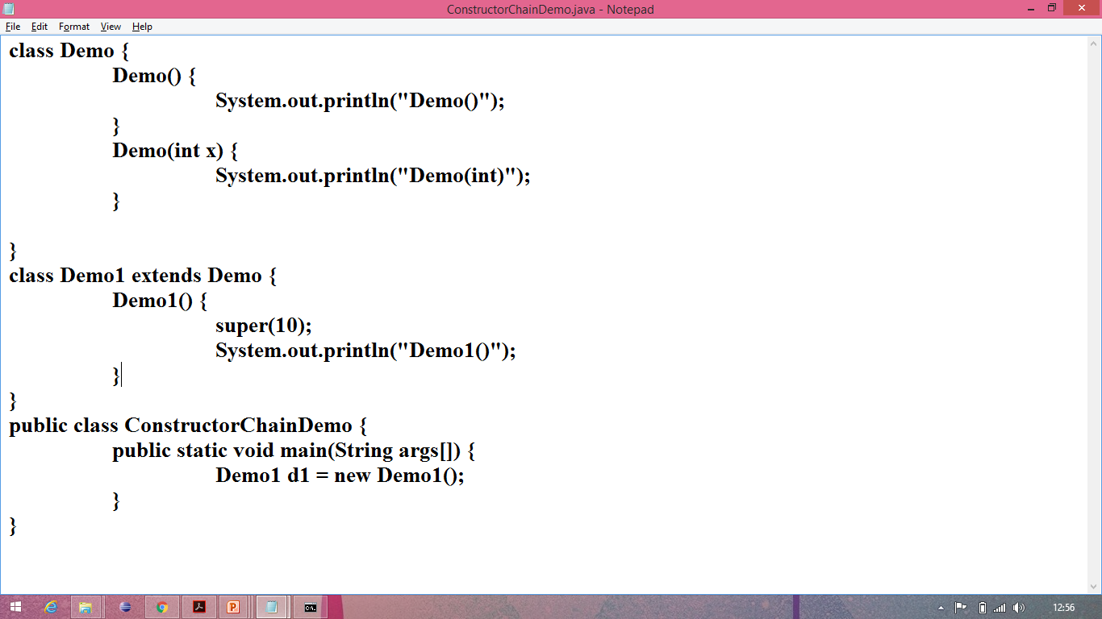
Constructor chaining in inheritance:

Slide 99
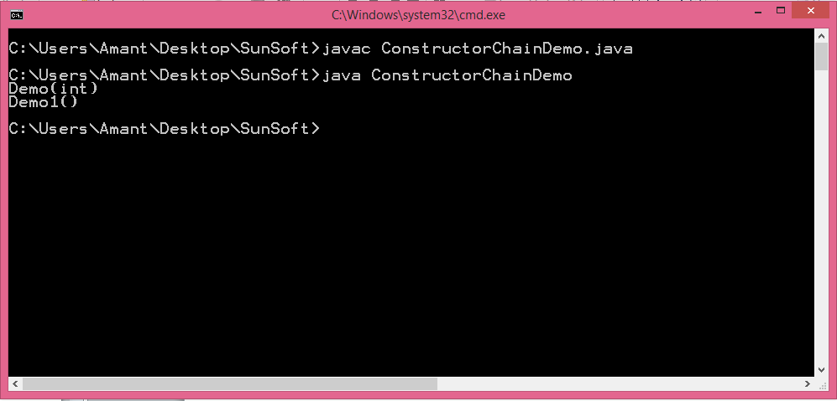
Constructor chaining in inheritance (contd.):

Slide 100
super
Super is keyword used to refer super class member from subclass but not in reverse
By default every subclass contain super class constructor which non-parameterized constructor

Slide 101
Example for super key word
Demo :
class A
{
int a=34;
void add(){}
}
class B extends A
{
super.add();
System.out.println(super.a);
}

Slide 102
Polymorphism
In polymorphism Object will behave differently in deferent situation
Ex : press switch one time fan will on,
press it again fan will be off
There are two types of polymorphism
1.compile time polymorphism
2.run time polymorphism

Slide 103
Run time polymorphism
Runtime polymorphism or Dynamic Method Dispatch is a process in which a call to an overridden method is resolved at runtime rather than compile-time.
This can be achieved by method overriding

Slide 104
Method Overriding
Overriding is the process of writing same method name with same signature in subclass
Demo :
class A
{
void add(){}
}
class B extends A
{
void add(){}
}

Slide 105
Compile time polymorphism
Compile time polymorphism is a process in which a call to an overridden method is resolved at compile-time.
This can be achieved by using methods overloading

Slide 106
Method Overloading
Overloading is the process of writing same method name with different parameter in same class
Demo ;
class A{
void add(){}
void add(int a){}
}

Slide 107
Abstraction
Abstraction is used to hiding internal Implementation and showing required feature
Abstract is key word applicable for methods and class
Object can not be create for abstract class
Method body should not be given for abstract method
With abstract 100% abstraction is not possible

Slide 108
Abstraction Demo
class A{
abstract void add();
}
class B extends A{
void add(){}
}
public class M{
public static void main(String[] args){
//A a=new A();
B b=new B();
}
}

Slide 109
interface
With interface 100% abstraction can be achieved
With Interface we can achieve multiple inheritance
All variable in interface are default public static final
All method are public abstract
You can not create Object of Interface

Slide 110
Demo for Interface
interface I{
public static final Int i=10;
public abstract void add();
}
class A implements I{
public void add(){}
}

Slide 111
interface can not have constructer
interface can extends another interface
class can implements interface
Marker Interface
The interface which does not contain any thing or empty
it is just instruction to java
ex : cloneable interface , serializable interface

Slide 112
Non access modifier static abstract final
static
static is key word applicable for variable method
static member will load in memory when class is loading in to the memory
static member can be access with class name without creating an Object of the class
instance variable can not be declare in static member

Slide 113
Static variable
static variables are also called as ‘Class variables’.
static variables are declared inside a class with ‘static’ keyword, but outside any block like methods or constructor.
static variables have only one copy throughout the class regardless of number of object created.
static variables are stored in static memory.
It is mostly used to declare constants.
Default values of static variables are same as instance variables.
static variables can be invoked by calling the class name.
className.variable_name

Slide 114
abstract
abstract is a key word applicable to class method
When we define method as abstract we should not declare body for that method
When we declare class as abstract then we can not create Object for that class
abstract class will have constructor

Slide 115
Keyword ‘final’
‘final’ is key word applicable for class and variable and method
final variable value can not change it is constant
final method can not be override
final class cannot be extend

Slide 116
abstract classes
The class which contain abstract key word is called abstract class
abstract method will not have body
if we declare any method as abstract then that class should be declare as abstract
We can not create Object of abstract class
abstract class will have constructor

Slide 117
We have to implement abstract method in subclass of abstract class otherwise we need to declare that subclass as abstract class
We can access all member of abstract by creating Object of super class

Slide 118
Demo :
abstract class A{
int a=12;
void show();
}
class B extends A{
void show(){
System.out.println(“show”);
}
}
public class{
public static void main(String[] args){
B b=new B();
Syste.out.println(b.a);
b.show();
}

Slide 119
Differences between abstract class and interface
abstract class
interface
This can have abstract as well as normal method
variable can be any instance, static final
Constructor are present in abstract classes
abstract class does not support multiple inheritance
100% abstraction is not possible
This will have only abstract method
variable are static final only
Constructor are absent in interface
interface support multiple inheritance
100% abstraction can be achieved

Slide 120
Type Conversions
Type conversion is the process of converting one type to another type
There are 2 type of type conversion
1 . implicit conversion
2 . explicit conversion
Implicit conversion is done by jvm internally
Explicit conversion has to done by developer

Slide 121
auto widening and explicit narrowing
Auto widening is the process of converting lower data types to higher data types
This will done by jvm internally
Ex : if we define byte b=12; and
int a=b;
and try to print ‘a’ then jvm will convert byte value to int value implicitly

Slide 122
Demo
class A{
public static void main(String[] args)
{
byte b=19;
int a=b;
byte c=a;
System.out.println(b); //convert into int
//System.out.println(c); //compilation error
}
}

Slide 123
explicit narrowing
The process of converting wide data type to narrow data type is called explicit narrowing
This has to be done by developer manually
if we assign value greater then data type capacity then we will get compilation error
We need to convert that data type to higher data type

Slide 124
Demo :
class A{
public static void main(String[] args)
{
int a=129
byte b=a;
//System.out.println(b); //error
byte bb=(byte)b;
System.out.println(bb); //129
}
}

Slide 125
auto upcasting and explicit downcasting
When you assign sub class Object to super class reference variable then it is called upcasting
jvm will automatically convert that subclass Object to super class Object so this is called auto upcasting

Slide 126
Demo ;
class A{
int i=5;
}
class B extends A{
int f=45;
}
class Demo{
public static void main(String[] args){
B b=(B)new A(); //upcasting
}

Slide 127
explicit downcasting
When you assign super class Object to sub class reference variable then you will get class cast Exception
In order to do that we need to convert super class Object to sub class Object explicitly
jvm will not do downcasting developer has do that

Slide 128
Demo :
class A{
int i=5;
}
class B{
int f=45;
}
class Demo{
public static void main(String[] args){
A a=new B(); //down casting
}

Slide 129
InstanceOf Operator
Instance operator hold the address of the current Object
If we want to check any Object belong to the current class or not then you can use instanceOf operator

Slide 130
Demo ;
class str{
public static void main(String[] args){
str s=new str();
if(s instanceOf str){
System.out.println(s);
}
else{
System.out.println("no");
}
}
}

Slide 131
Packages in Java
Definition:
A package is a collection of classes, interfaces, sub packages and annotations.
Uses:
Code reusability.
To avoid naming collision i.e. to maintain more than one class with same but different functions.
Root package:
J2SE java
J2EE javax

Slide 132
Packages in Java (contd.)
create userdefined package:
To create a userdefined package we must write “package package_name” in our code.
Then during compilation we must use “-d . “.
Syntax:
javac –d . FileName
Note: While creating a package we must follow the order given below.
package import class

Slide 133
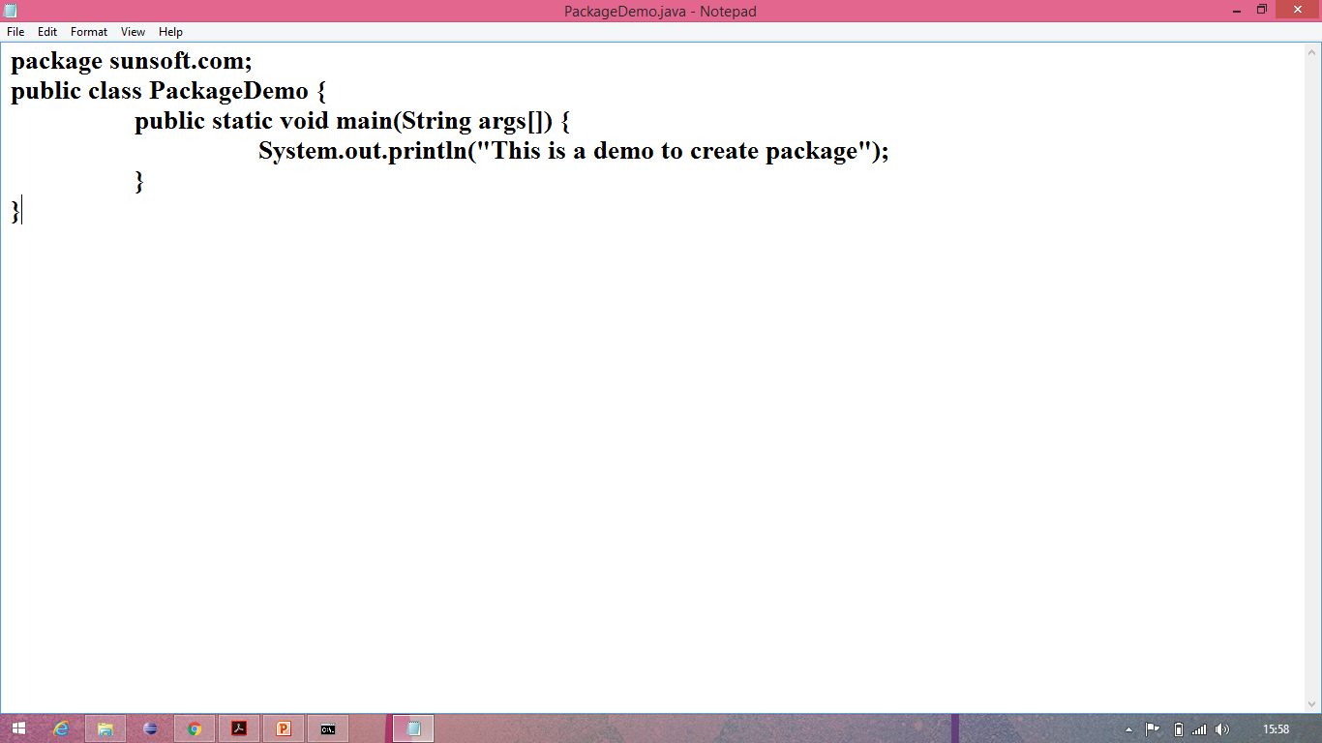
Packages in Java (contd.)
create userdefined package demo:

Slide 134
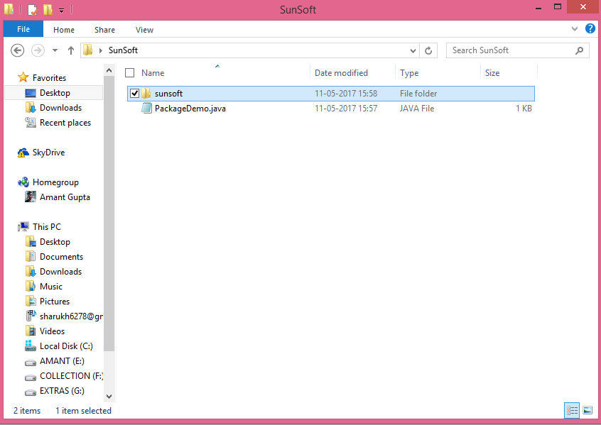
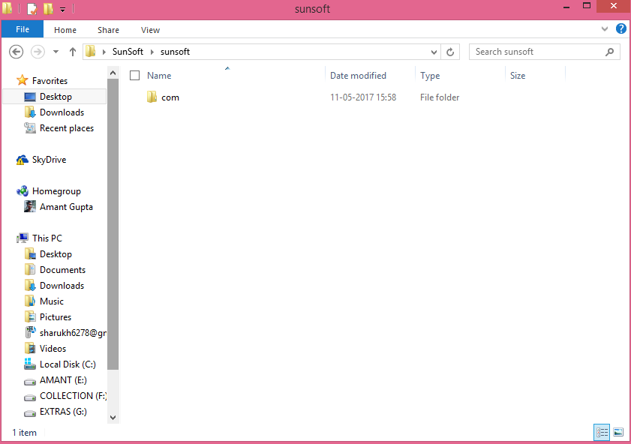
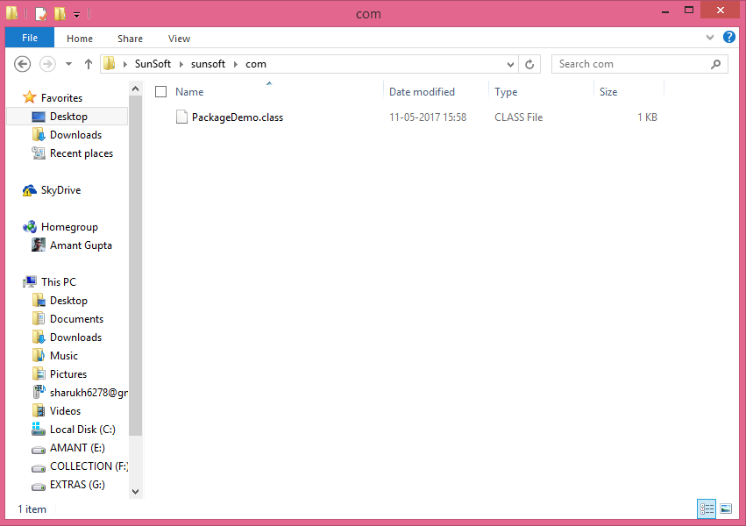
Packages in Java (contd.)
create userdefined package demo:

Slide 135
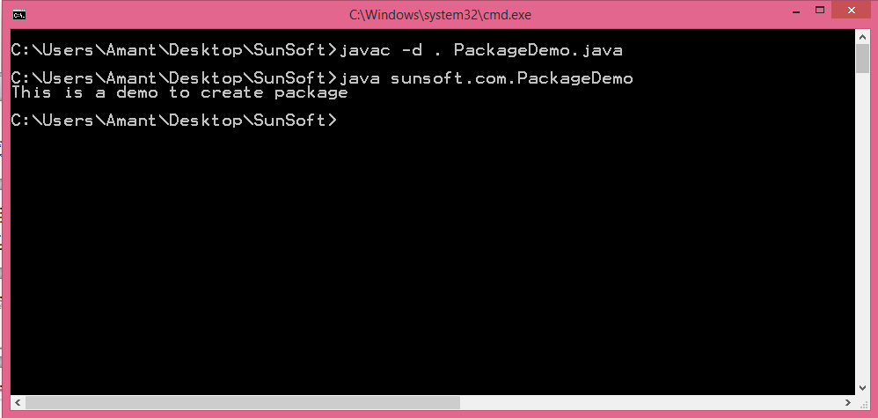
Packages in Java (contd.)
create userdefined package demo:

Slide 136
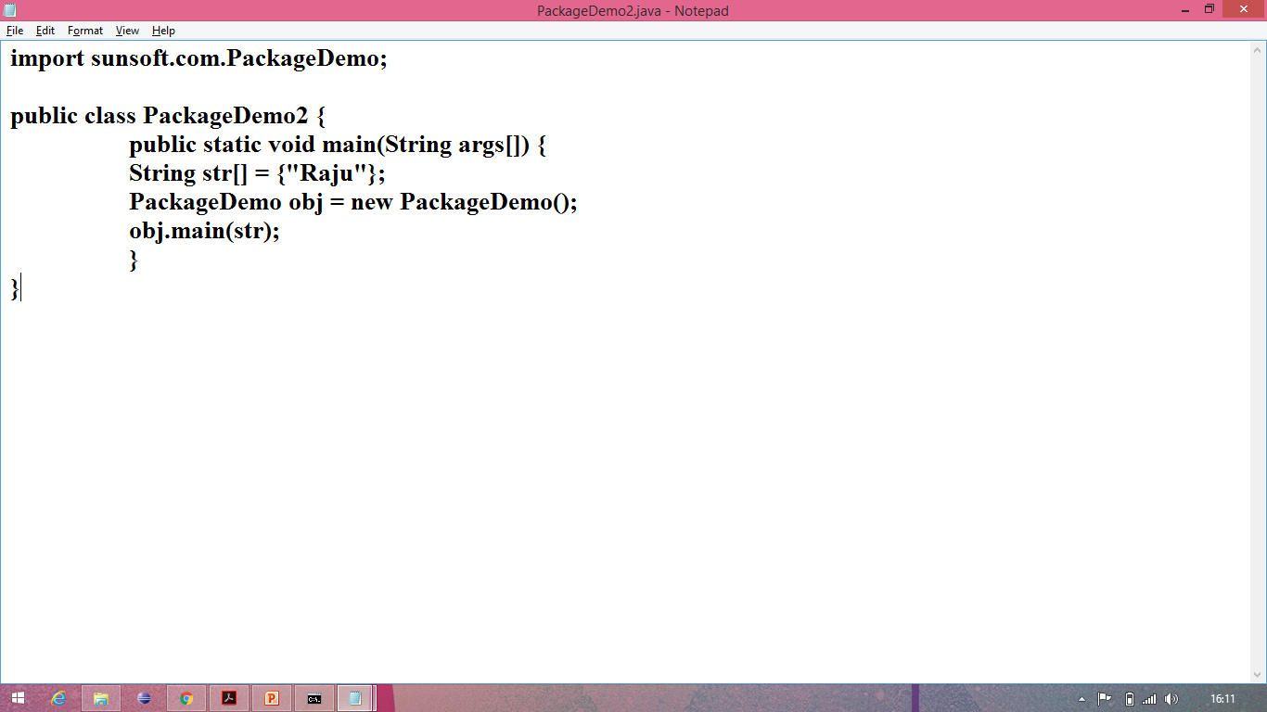
Packages in Java (contd.)
Importing the userdefined packages:

Slide 137

Packages in Java (contd.)
Importing the userdefined packages:

Slide 138
Access specifier
private
default
protected
public

Slide 139
Access specifier (contd.)
private scope: the scope of private access specifier is throughout the class.
default scope: the scope of default access specifier is throughout the package.
protected scope: the scope of protected access specifier is throughout the class as well as the sub classes of that class.
public scope: the scope of public access specifier is global i.e. it can be globally accessed.
Note:
‘private’ and ‘protected’ access specifier cannot be used by the outer class. They can only be used by the members of the class.
there is no keyword used for default access modifier.

Slide 140
Scanner class
Scanner class is used to take input from keyboard.
Scanner class breaks its input into tokens using a delimiter pattern, which by default whitespace.
Java Scanner class extends Object class and implements java.util.Iterator and java.io.Closeable interfaces.
Syntax to import Scanner class:
import java.util.*;
import java.util.Scanner;
Note: it is not advised to use import java.util.*; as it imports all the classes present in scanner class.

Slide 141
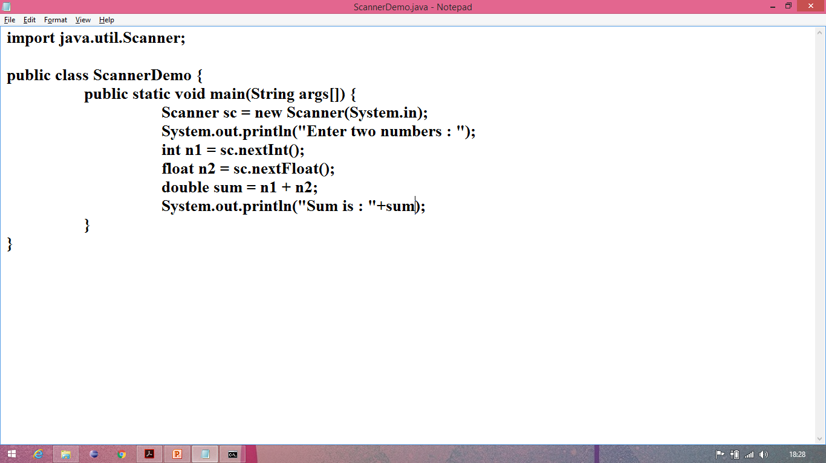
Scanner class (contd.)
Demo:

Slide 142
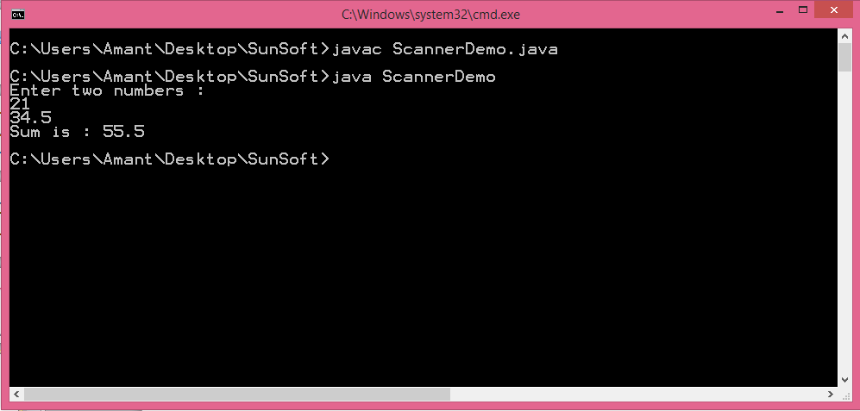
Scanner class (contd.)
Demo:

Slide 143
Exception
Unwanted and unexpected event occurs that disturb the normal flow of execution is called exception
ex: arithmetic Exception, null pointer Exception, array indexOutOfBound Exception
Main Objective of Exception Handling is to graceful termination of the program

Slide 144
Handling Exception does not mean repairing Exception it is to provide alternative to continue rest of the program normally.
ex : if you trying to access online file in case it is not available then file not found Exception will throw by jvm and terminate the program, to avoid abnormal termination of the program we need to provide local file to continue rest of the execution of the program normal.

Slide 145
Types of exception
1)Checked Exception : the Exception checked by the Compiler
Checked exception should be handle before compilation, with the help of try or throws key word otherwise it will raise Exception on compilation time
2)Unchecked Exception : run time Exception which will not be checked by the compiler

Slide 146
try Block
Risky code means the code which raise exception should be write in try block
try block is used handle both check and unchecked Exception
If exception raises in try block then control will transfer to catch block where Exception handling code will written
And control will not come back it will continue from catch block itself

Slide 147
catch Block
In this block the Exception handling code will written
If we did not handle the Exception then default Exception handler will handle the Exception and terminate the execution
Catch Block always followed by try

Slide 148
finally Block
Finally Block will always execute regarding of raising Exception
Finally always with be try or try catch block
Finally block mostly used to close the connection witch are open

Slide 149
Differences between final, finally, finalize()
final
final is a key word applicable to class variable , method
When you declare variable as final then its value cant be change
When you declare method as final then you can not override that method
When you declare class as final then you can not inherit that class

Slide 150
Differences between final, finally, finalize()
finally
Finally is a block always associated with try catch block
This block is used to write clean up code for open connection
finalize()
Is a method of Object whose work is to close the connection.
finalize() is called after the Object is destroyed.

Slide 151
Throw key word
Throw key word is used to throw Exception Explicitly
It is used in custom Exception to throw exception
ex : throw io Exception
We can throw checked and unchecked both Exception with throw key word
ex : arithmetic Exception

Slide 152
Throws key word
Throws is a key word used to handle checked exception
ex: io Exception
Throws key word does not handle unchecked exception for that we need to use try catch block to handle run time Exception
Using throws key word when run time Exception is raising is useless

Slide 153
Exception hierarchy
Throwable class act as root class for all java Exception
Throwable class define two more child classes
1.Exception 2.Error
Exception are mostly caused by our program and these can be recoverable
Error are mostly caused by lack of system resources and cannot be recoverable and all Error and its subclass are unchecked

Slide 154
Differences between checked and unchecked Exception
checked Exception
unchecked Exception
This exception checked by compiler
Throws key word and try catch block is used to handle this Exception
Ex :
io exception
Compiler will not check this Exception
Try catch block are used to handle this Exception
Ex
Arithmetic Exception

Slide 155
Handling all type of Exception
We can handle all type of Exception in catch block
Write number of catch block as number of Exception you want to handle
Order is important for that you can give catch(Exception e) in last
You can write only one catch block to handle many Exception by using || when handling code is similar for all Exception

Slide 156
Custom Exception
User defined Exception is called as custom Exception
Ex : invalid password or user name or insufficient fund etc.
We can create both checked and uncheckedException
For that if you want create checked Exception then your class must Extends Exception class

Slide 157
If you want create run time Exception then you need to extends your class with RuntimeException
syntax
class ClassName extends RuntimeException

Slide 158
1.Can we write try without catch
No try always comes with catch block

Slide 159
2.Can we write catch without try
No catch always followed by try block

Slide 160
3.Can we write first catch and then try
No catch always followed by try block

Slide 161
4.Can we write try then finally
Yes try should either with catch or finally

Slide 162
5.Can we write
Finally then try
No finally should be below try or catch block

Slide 163
6.Can we write
Try with multiple catch
yes

Slide 164
7.Can we write
Try catch inside try block
yes

Slide 165
Predefined packages
Predefined packages are inbuilt package which contain useful classes interface and method
java.lang
java.io
java.util

Slide 166
lang package
This is predefined package that is java.lang
By default lang package in imported in java
lang package contain some useful classes and interface that are required to develop the simple java program
Object , class String , StringBuffer , StringBuilder , Math…..etc. class are belong to the java.lang package

Slide 167
io package
This is predefined package that is java.io
Manually java.io package need to be imported
io package contain some useful class and interface that are required to handle files
File , serialization, Externalization , …..etc. class and interface are belong to the java.io package

Slide 168
util package
This is predefined package that is java.util
Manually java.util package need to be imported
util package contain some useful class and interface that are required for utility purpose
Arrays ,Collection, Collections, Date, …..etc. class and interface are belong to the java.io package

Slide 169
Multi-threading java.lang.Thread

Slide 170
Program :
Set of Instruction to Perform a specific task
Process :
Time taken to Execute the Code
Processor :
it executes the Code
Thread :
Small execution of Code within process
Thread is light weight Process
Java is Thread based language
C and C++ are process based language

Slide 171
Multi-tasking :
executing several task simultaneously
Multi-processing :
executing several task simultaneously where each task is independent of each other
ex: typing program listening music downloading file simultaneously

Slide 172
Multi-threading :
executing several task simultaneously where each task is independent of each but they are part of the same program
Ex: executing 2 separate block of the same program simultaneously
Thread scheduler :
is component of jvm whose work is to schedule the thread execution

Slide 173
Some common method of Thread class
currentThread() :
gives current thread details
sleep() :
used to sleep the thread
suspend() :
used to suspend the thread
resume() :
used to resume the thread
wait() :
used to wait the thread

Slide 174
notify() :
notify the thread which is waiting
notifyAll() :
notify all thread which are waiting
start() :
used to start new thread
stop() :
stop the thread
join() :
thread waits until another thread done its execution

Slide 175
setName() :
used to set the name to thread
getName() :
used to get the name of thread
setPriority() :
used to set the Priority to thread
getPriority() :
used to get the priority
activeCount() :
give the number of active thread

Slide 176
isDaemon() :
returns boolean value
setDaemon() :
used to set thread Daemon
yield() :
checks any thread waiting which are having priority value greater then this thread if available it will give chance to execute the thread and goes into waiting state

Slide 177
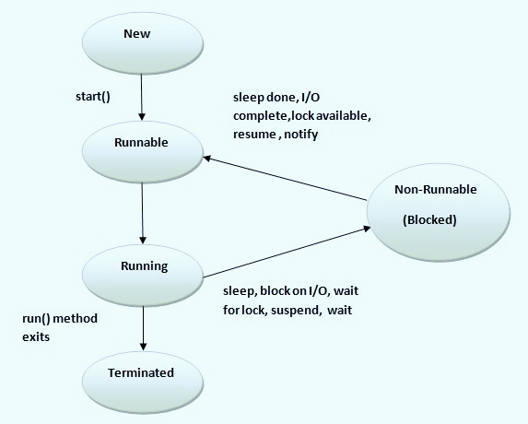
Thread life cycle
1.New
2.Runnable
3.Running
4.Non-Runnable (Blocked)
5.Terminated(dead)

Slide 178
New :
new thread is created before calling start ()
Runnable :
thread is runnable state after calling start()(means its ready to run)
Running :
Thread is in running state if thread scheduler allocate the thread to the processor
Non Runnable(Blocked) :
alive thread but not in running state
Terminated(Dead) :
thread is in dead state(Terminated)

Slide 179
Thread is pre-defined class belong to the package java.lang.Thread
Demo :normal program
class A
{
public static void main(String[] args)
{
for(int i=1;i<=20;i++)
{
System.out.println(“I =”+i);
}
}
}

Slide 180
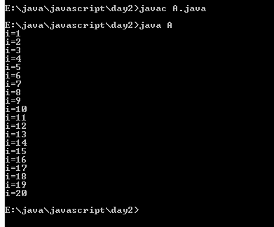
Output : 1st and 2nd run

Slide 181
In 2 ways we can achieve multi-threading
1.extending Thread class
2.implementing runnable interface
1.extending Thread class
we need to extends Thread class and override run()
Create Object of our class
call start() on object of our class
Calling start() will create new thread and automatically invoke run()

Slide 182
Demo :
class A extends Thread
{
public void run()
{
For(int i=1;i<=20;i++)
{
System.out.println(“i =“+i) ;
}
}
}
class ThreadDemo
{
Public static void main(String[] args)
{
A a1=new A();
A a2=new A();
a1.start();
a2.start();
}
}

Slide 183
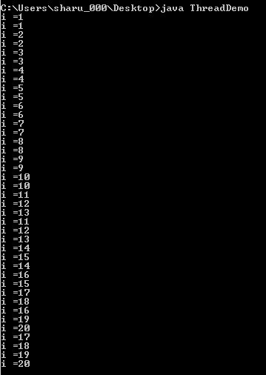
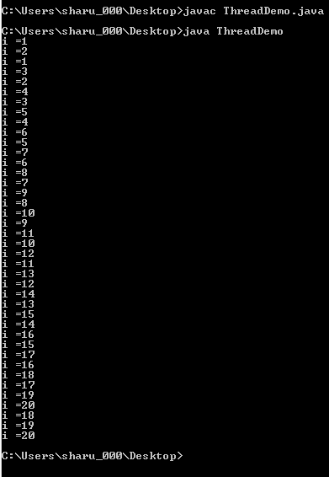
Output :
1st run 2nd run

Slide 184
Implementing runnable interface
Runnable is an interface Available in java.lang package
To create thread we need to implements runnable interface to our class and override run() method
create Object of the class ,then create Thread Object by passing your class Object as parameter and call start method on Thread Object reference

Slide 185
Demo :
class A implements runnable
{
public void run()
{
for(int i=1;i<=20;i++)
{
System.out.println(Thread.currentThread.currentThread.getName()+i);
}
}
}
class ThreadDemo
{
public static void main(String[] args)
{
A a1=new A();
Thread d1=new Thread(a1);
Thread d2=new Thread(a1);
d1.start();
d2.start();
}
}

Slide 186
Output :
1st run 2nd run

Slide 187
Difference between start() and run()
Calling start() will create new Thread ,calling run() will not create any thread it will execute as normal method
You can’t call start method twice on same thread it will throw Exception
run() will automatically invoke when we call start()

Slide 188
Thread Priorities
Based on thread priority processor will execute the thread
Java threads priority is range between 1 to 10
1. public static int MIN_PRIORITY=1
2.public static int NORM_PRIORITY=5
3.public static int MAX_PRIORITY=10
The thread which is having MAX_PRIORITY will execute first
The threads which is having MIN_PRIORITY will execute last

Slide 189
Thread Priorities
Default priority is 5 for main thread
Priority will be inherited from parent thread to child thread means if you not given priority to your nondaemon thread it will inherit the priority from main thread
setPriority() is used to set the priority for thread
getPriority() will return priority of thread that is int value

Slide 190
Daemon Thread
Daemon threads are those thread which provides support for other thread or non-daemon Threads
Daemon threads will run in back ground
Ex : Garbage collector, main Thread
Daemon Thread priority will less then non-daemon thread but based on situation jvm will increase their
thread priority

Slide 191
if their is no thread then jvm will terminate the daemon thread
Methods for Daemon threads
1. public void setDaemon(boolean status)
used to set thread as Daemon Thread
2. public boolean isDaemon()
return boolean value checks the thread is Daemon or not
To make thread as daemon it should set Daemon before it starting otherwise illegalthreadstateException will throw

Slide 192
Thread Pool
thread pool is group of thread or worker threads which are waiting for job
Advantage of thread pool is we can reuse the thread as many time hence performance will be increases
In thread pool a group of fixed number of threads create and a thread from thread pool will be pulled and assign the job
After completion of the job the thread will go back into the thread pool

Slide 193
thread pools are used in jsp and servlet where container creates a thread pool to process the request
The following code will create thread pool of 10 threads
ExecutorService executor = Executors.newFixedThreadPool(10)

Slide 194
Thread group
Java provides a convenient way to group multiple threads in a single object
Thread group can be used to suspend resume interrupt group of thread by single method
Thread group implemented by java.lang.ThreadGroup

Slide 195
Constructors of ThreadGroup class
ThreadGroup(String name)
create thread group of given name
2. ThreadGroup(ThreadGroup parent, String name)
create thread group of given parent group and name
Methods in ThreadGroup
int activeCount()
returns no. of threads running in current group

Slide 196
2. int activeGroupCount()
returns a no. of active group in this thread group
3. void destroy()
Destroy the thread group and all its subgroup
3. String getName()
returns the name of the group
4. ThreadGroup getParent()
returns the parent of this group
5. void interrupt()
interrupt all the thread of the thread group

Slide 197
Synchronization
Synchronization is key words applicable on methods and blocks
Synchronization will allow to execute only one thread at time To prevent thread interference
Synchronization also prevent consistency problem
ex :banking , seat booking

Slide 198
1.Can we start a thread twice ?
No (java.lang.IllegalThreadStateException)

Slide 199
2.Can we overload the run() ?
Ans: : yes, but start method always look for default run() if not available then no output)

Slide 200
3.Can we override start() ?
Ans :yes, but it will invoked as normal method

Slide 201
4.What will happen if we call run() directly ?
Ans : it will execute as normal method

Slide 202
Object class
Object is a predefined class in java.lang package.
Object class is the root class of all the classes in java.lang package.
Object is the default super class of all the classes in java.lang package.
When we define any class without extending any other class then Object class will be direct super class otherwise Object class will be indirect super class.
The members available in this class can be referred with any type of reference like class, interface, array etc.
Object class reference variable can hold any type of object.

Slide 203
Object class
Some useful methods:
public final native Class getClass()
public native int hashCode()
public String toString()
public boolean equals(Object)
protected native Object clone()
protected void finalize()
public final native void notify()
public final native void notifyAll()
public final void wait(

Slide 204
String, StringBuffer, StringBuilder
String:
String class is present in java.lang package.
String objects are immutable.
When you try to modify the contents of object then new object is created.
String class is final i.e. it cannot be extended.
String class implements the following interfaces:
java.io.Serializable
java.lang.Comparable
java.lang.CharSequence
String object can be created in two ways:
Without using new keyword.
By using new keyword.

Slide 205
String, StringBuffer, StringBuilder (contd.)
Creating String object without new keyword:
JVM allocates the memory for the String reference variable.
JVM verifies the String literal in the String Constant Pool.
If String literal is not available in the String Constant Pool then it creates new String object inside the String Constant pool and the newly created String object address will be assigned to String reference variable.
If String literal is available then existing String object address will be assigned to String reference variable.

Slide 206
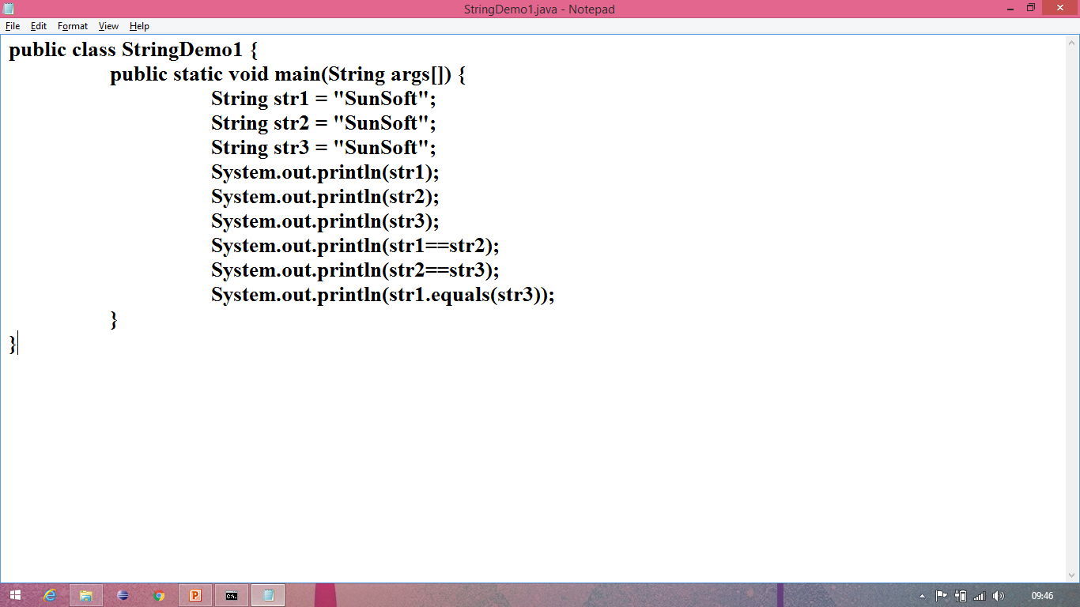
String, StringBuffer, StringBuilder (contd.)
Creating String object without new keyword Demo:

Slide 207
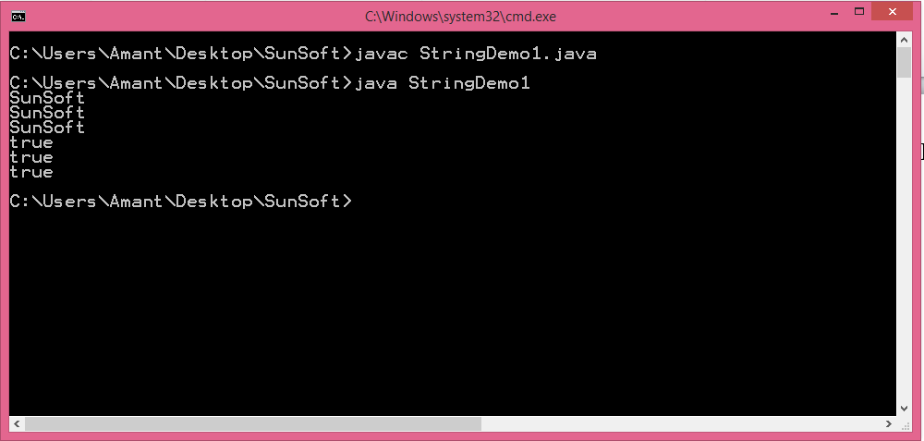
String, StringBuffer, StringBuilder (contd.)
Creating String object without new keyword Demo:

Slide 208
String, StringBuffer, StringBuilder (contd.)
Creating String object with new keyword:
JVM allocates the memory for the String reference variable.
JVM verifies the String literal in the String Constant Pool.
If String literal is not available in the String Constant Pool then it creates new String object inside the String Constant pool.
If String literal is available in the String Constant Pool then ignores that.
It creates another new String object outside the constant pool and assigns address of the newly created String object outside the pool to String reference variable.

Slide 209
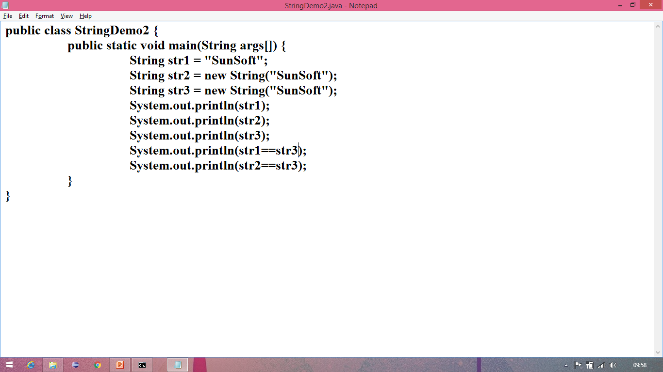
String, StringBuffer, StringBuilder (contd.)
Creating String object with new keyword Demo:

Slide 210
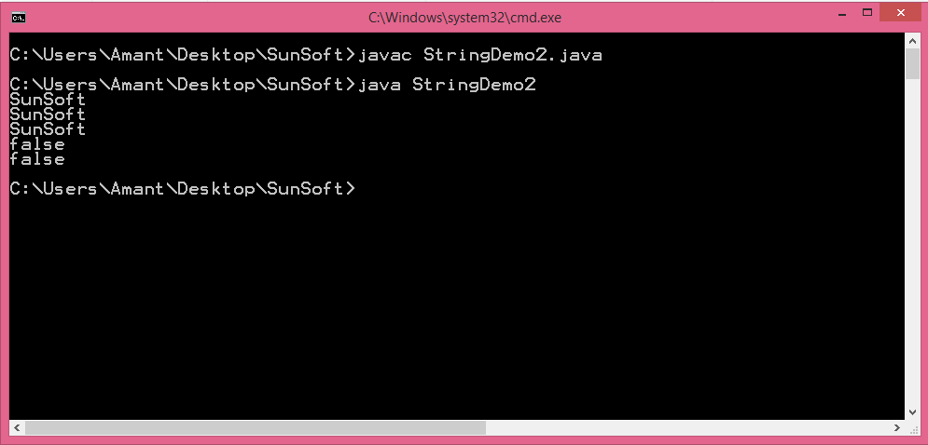
String, StringBuffer, StringBuilder (contd.)
Creating String object with new keyword Demo:

Slide 211
String, StringBuffer, StringBuilder (contd.)
Some useful methods in String class:
public int length()
public boolean isEmpty()
public String concat(String)
public String toLowerCase()
public String toUpperCase()
public String trim()

Slide 212
String, StringBuffer, StringBuilder
StringBuffer:
StringBuffer is a final class in java.lang package.
StringBuffer is mutable i.e. the content of StringBuffer can be modified after creation.
Every StringBuffer object has a capacity associated with it.
The capacity of StringBuffer is the number of characters it can hold.
The capacity increases automatically as more contents added to it.
The methods available in StringBuffer class are synchronized.
In StringBuffer class multiple threads cannot access simultaneously.
To sole this problem StringBuilder is added from Java 5.

Slide 213
String, StringBuffer, StringBuilder (contd.)
Some useful methods in StringBuffer class:
StringBuffer append(X value)
int capacity()
int length()
void setLength(int len)

Slide 214
String, StringBuffer, StringBuilder
StringBuilder:
StringBuilder is a final class in java.lang package.
StringBuilder is added from Java 5.
StringBuilder class functionality is same as StringBuffer only except that the methods available in StringBuilder class are non synchronized.
In StringBuilder class multiple threads can execute simultaneously.

Slide 215
String, StringBuffer, StringBuilder (contd.)
Some useful methods in StringBuilder class:
StringBuffer append(X value)
int capacity()
int length()
void setLength(int len)

Slide 216
Math class
It is a final class in java.lang package.
It contains methods for performing basic numeric operations.
The constructor of Math class is private so you cannot create the object of Math class.
All the members of Math class is static so it can be accessed by using class name.

Slide 217
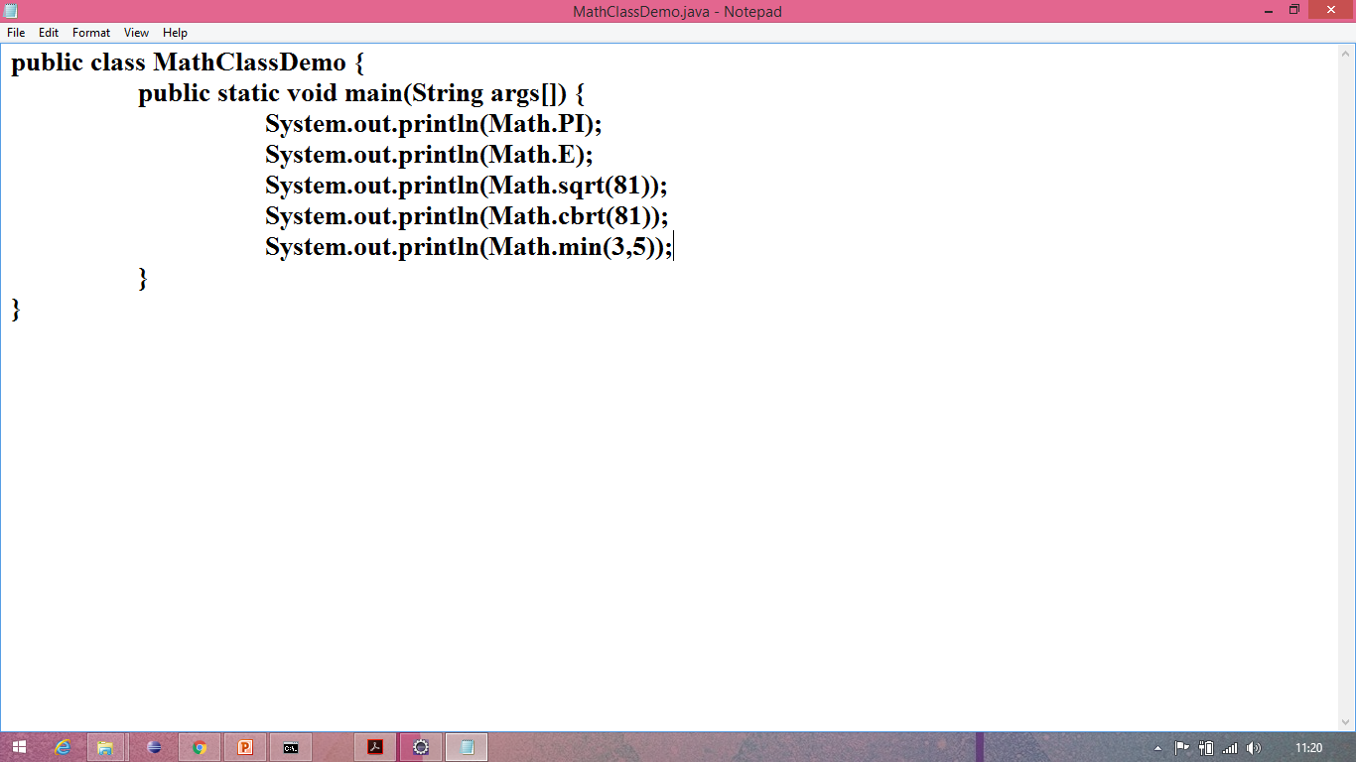
Math class
Math class demo:

Slide 218
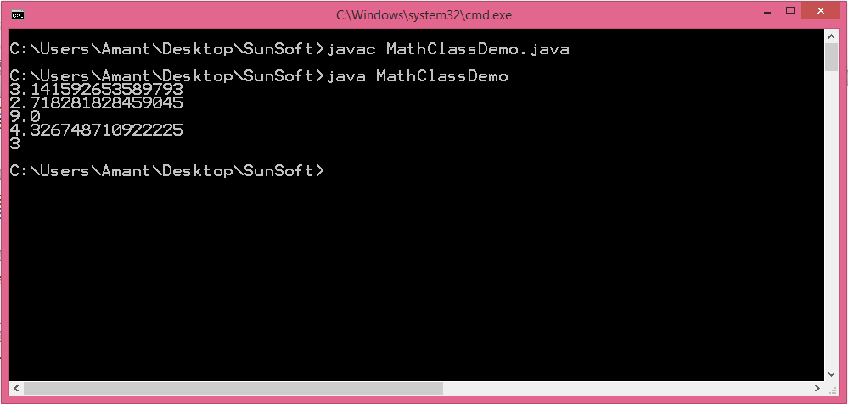
Math class
Math class demo:

Slide 219
Runtime and Process class
Runtime class:
Runtime class is present in java.lang package.
Every java program has the single instance of this class to allow the application to interact with the environment.
Runtime class is used for memory management and executing additional process.
You can define the reference of Runtime class but you cannot create the object of Runtime class.
The methods of the Runtime class are defined as instance, so you need to use some object to invoke the methods.
Runtime class is implemented using singleton design pattern i.e. only one object of that class will be available per JVM.

Slide 220
Runtime and Process class
Process class:
Process class is present in java.lang package.
Process class provides methods for the following operations:
Taking input from the process
Giving output to the process.
Waiting for the process to complete.
Destroying the process.

Slide 221
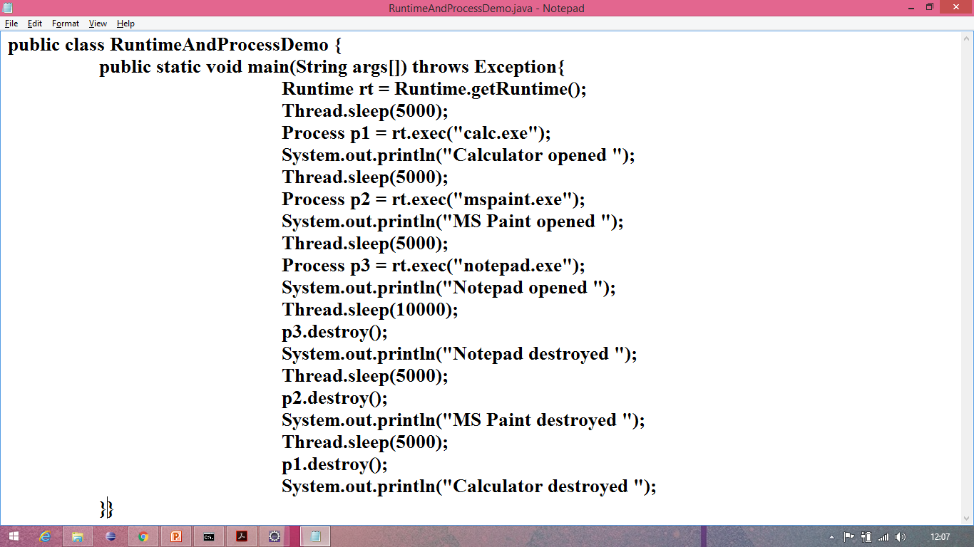
Runtime and Process class
Demo:

Slide 222
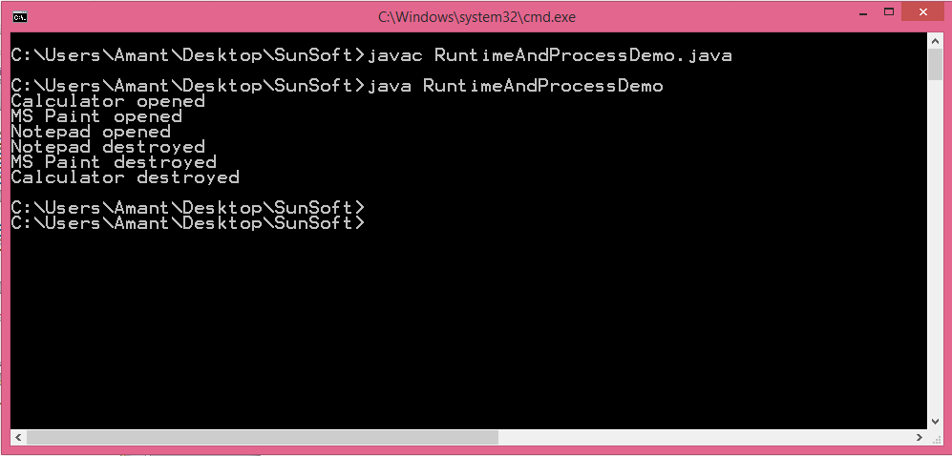
Runtime and Process class
Demo output:

Slide 223
Util Package Classes
Following are the useful classes of util package
Date
Stack
StringTokenizer
BitSet
Scanner etc.

Slide 224
Date class
Date Is a utility class present in util package used to handle all date operation
You can import util package like java.util.Date;

Slide 225
Ex
import java.util.Date;
public class Dat {
public static void main(String[] args) {
Date d=new Date();
System.out.println(d);
}
}

Slide 226
Stack class
The java.util.Stack class represents a last-in-first-out (LIFO) stack of objects.
It is synchronized class
In this class, the last element inserted is accessed first
It is a legacy class not in use

Slide 227
StringTokenizer
It is class present is java.util.StringTokenizer
It is used to split a String into diffrent tokens by defined delimiter
You can defined more token in StringTokenizer to split String into different Token

Slide 228
Ex :
import java.util.*;
public class StringTokenizerDemo {
public static void main(String[] args) {
String str="raja,smaeer.raheem;sham:";
StringTokenizer s=new StringTokenizer(g,",.:;");
while(s.hasMoreTokens()){
System.out.println(s.nextToken());
}
}
}

Slide 229
Out put :
raja
smaeer
raheem
sham

Slide 230
BitSet class
The BitSet class creates a special type of array that holds bit values
The BitSet array can increase in size as needed
This is a legacy class but it has been completely re-engineered in Java 2, version 1.4.

Slide 231
Scanner class
Scanner class is a final class in java.util.Scanner
Scanner class is used to read the data from input devices

Slide 232
Demo :
Import java.util.Scanner;
class A{
public static void main(String[] args){
System.out.println(“enter value”);
Scanner in =new Scanner();
String s=in.nextLine();
System.out.println(s);
}}

Slide 233
Collection
Collection is a interface available in java.util package
Collection is used to represent group of Object as a single entity
Collections having so many advantage over arrays so that collection is using widely

Slide 234
Differences between array and Collection
Disadvantages of array
Array hold homogenous data type
ex : int a[]=new int[5];
Array size is fixed means after initializing an array you cannot change the size of an array
Size of an array has to declare while initializing an array
Performance will be low when operation is insertion and deletion

Slide 235
Advantages Collection
Collection hold heterogeneous element
ex : ArrayList al=new ArrayList();
Collection are growable in nature means size is not fixe
no need to declare any size while initializing an Collection
ex: LinkedList l=new LinkedList();
The root class of Collection is iterable interface

Slide 236
Some of the common method in Collection
1.add(Obj) : to add element
2.addAll(Collection c) : to add Collection
3.remove(obj) : to remove object
4.removeAll(Collection c) : remove Collection
5.retainAll(Collection c) : remove remaining element except these collection
6.size() : return size of the collection
7.clear() : remove all element from collection

Slide 237
8.contains(Obj) : return true if object is present
9.containsAll(Collection c) : return true if collection is present
10.isEmpty() : return true if no element in collection
11.toArray[] : convert Collection to Object Array

Slide 238
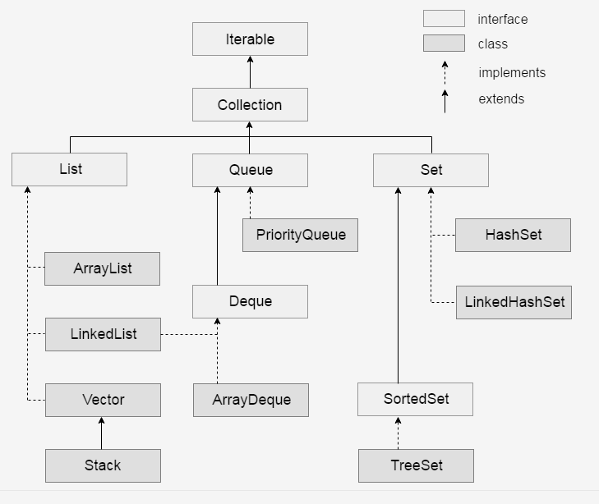
Classification of Collection

Slide 239
Classification of Collection
Iterable
Collection
List
Queue
Set
List
1.ArrayList
2.LinkedList
3.vector
stack

Slide 240
1.ArrayList
It store element in indexing notation means in continuous memory location
It allow duplicate element
It store element in user added order
Performance is good when operation is retrieval operation
Performance is poor when operation is insert ,delete (more shifting of element)
It is non Synchronized

Slide 241
Syntax to create ArrayList and methods
ArrayList al=new ArrayList();
Methods:
It implements Collection so Collection all method will be access
1.add(int a, Obj) : add element on specified index
2.remove(int a) : remove element from specified index
3.lastIndexOf(obj) : returns the last occurrence index of specified element

Slide 242
4.addAll(int index, Collection) : adding Collection into collection from specified index
5. indexOf(Object o) : return index of specified Object
ArrayList implements random-access interface so retrieval operation is fast

Slide 243
Difference between Array and ArrayList
Array
ArrayList
Array is static (fixed size)
Need to specify size while creating array object
Need length property to get size of array
Need to specify type of element or data type
it is dynamic (growable size)
No need to specify size
Need size() to get length of collection
No need to specify type of elements or data type

Slide 244
LinkedList
It store the element in doubly linked list
It allows duplicate element
it is non Synchronize
The performance is good when Operation is insert and deletion
The performance is poor when Operation is Retrieval
It does not implement randomAcess interface

Slide 245
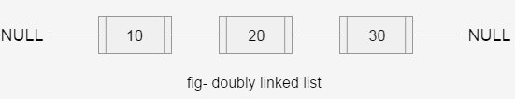
Storing of element
Syntax to create LinkedList
LinkedList al=new LinkedList();

Slide 246
Methods in LinkedList
1.add(int index, Obj) : add element in specified index
2.addFirst(Obj) : add element on beginning index
3.addLast(Obj : add Object on last
4. Object getFirst() : return first element
5. Object getLast() : return last element
6. int lastIndexOf(Object o) : return index of last element

Slide 247
Differences between ArrayList and LinkedList
ArrayList
LinkedList
Stores element in indexing notation
Performance is fast when operation is retrieval
Performance is poor when operation is insert delete
Occupies less memory
It stores elements in doubly linked list
Performance is poor when operation is retrieval
Performance is fast when operation is insert delete
Occupies more memory as links contain address of elements

Slide 248
Vector and stack
Vector is a legacy class
All methods are synchronized
Stores element in index
It allow duplicate element
growable in nature
null insertion is allowed
Stack is not in use we other class which better then stack like HashSet

Slide 249
Differences between vector and ArrayList
Vector
ArrayList
Methods are Synchronized
You can use any cursor to access elements
It is thread safe means multiple thread will not access this object
Methods are non synchronized
You cant use Enumeration cursor to access elements
It is not thread safe means
multiple thread can access this object

Slide 250
Enumeration interface
It is interface available in java.util package
It is an cursor to access the elements form legacy classes one by one
Methods
1.boolean hasMoreElements() :checks whether next element available or not
2.Object nextElement() : moves the pointer and returns elements from collection

Slide 251
Iterator interface
This is a cursor used to access elements from collection one by one
Invoke iterator() on collection to get instance of iterator ex: iterator i=col.iterator()
Methods
1.hasNext() : checks whether next element available or not
2.next() : moves the pointer and returns elements from collection
3.remove() : remove the current element from the collection

Slide 252
Differences between Enumeration and iterator
Enumeration
Iterator
It is legacy interface
It is used to access elements from legacy classes(vector, stack,
HashTable)
You can not remove elements using this
It is collection framework interface
It is universal cursor can be used to access elements from all class
You can remove elements
by Iterator

Slide 253
ListIterator
It extends iterator interface
Used to access the elements
Access the elements both forward and reverse direction
Add, remove, replace operation can be done
Access elements from specified index

Slide 254
Differences between ListIterator and Iterator
ListIterator
Iterator
It can be used to access elements from any Collection class
Can access elements Both forward and reverse direction
You can add, remove replace elements
With this you can access elements from specified index
It is used to access elements from list and its subclasses
Can access elements in forward direction only
You can only remove the elements
With this you can access elements from beginning only

Slide 255
Queue
Queue is an interface
PriorityQueue is famous class of this interface
Syntax to create Queue
PriorityQueue pq=new PriorityQueue();

Slide 256
Methods in Queue
offer(object): used to add Object
Object poll() : used to retrieve and remove head of the Queue
Object peek() : used to retrieve and not remove head of the element
Object element() : used to retrieve element but not remove head

Slide 257
Set Interface
It is not allowed duplicate elements
It uses hash code and equals() to add Object
Methods are same as Collection interface
classes in Set
1.HashSet
2.LinkedHashSet
3.TreeSet

Slide 258
1.HashSet
It store elements in unordered
It is fast for searching and retrieval operation
Duplicate are not allowed
2.LinkedHashSet
It is subclass of HashSet
It store elements in user added order

Slide 259
3.TreeSet
It stores elements in sorted order
compareTo() and Comparable interface is used to sort the elements
It allows to store similar type elements only
Null value insertion is not allowed
syntax to create TreeSet
TreeSet t=new TreeSet();

Slide 260
Differences between List and Set
List
Set
It can hold duplicate elements
You can add elements to the required position
You can remove elements from the required position
It does not store elements in sorted order
It cant hold duplicate elements
You can not add elements to the required position
You can not remove elements from the required position
It store elements in sorted order

Slide 261
Map Interface
It is Collection frame API but does not extends Collection interface
Map is an Object that amps or store key and value
The key Is always unique and value can be same
One value one key pair is known as one map entry

Slide 262
Method s in Map
1.Int size() : return number of entry of map
2.isEmpty() : return true if map is Empty
3.containskey(Obj) : return true if key is available
4.containsValue(Obj) : return true if available
5.get(key) : return Object of specified Key
6.put(k ,v) :add map entry
7.clear() : remove all elements
8.PutAll() : add map into map

Slide 263
Classes of Map
1.HashMap
LinkedHashMap
2.TreeMap
3.HashTable
1.HashMap
It is fast for searching and inserting elements
It store elements in unordered

Slide 264
LinkedHashMap
It is a subclass of HashMap
Elements Store in user added order
3.TreeMap
It store elements in sorted order
compareTo() and Comparable Interface I s used to sort elements
It allow similar type of elements only
Null value cannot be stored

Slide 265
Generics
Collection can hold any data type so while performing some operation on data there mat chances of Exception
Generics is used to restrict the user to provide homogenous data type
Diamond operator is use for that
ex: ArrayList<String>=new <String>ArrayList();

Slide 266
Collections class
Collections is utility class present in util package
Collections class utility methods that can be used to manipulate the Collection element like sorting ,shuffling, searching etc.

Slide 267
Demo :
import java.util.*;
class col{
public static void main(String[] args){
ArrayList l=new ArrayList();
l.add("raju");
l.add("raam");
l.add("raheem");
System.out.println(l);
Collections.shuffle(l);
System.out.println(l);
}
}

Slide 268
static import
static import allows programmer to access any static member of class directly.
static import was introduced from Java 5.
static import shorten the code.
Syntax:
import static java.lang.Math.*;
import static java.lang.System.*;

Slide 269

Static import (contd.)
Demo:

Slide 270

Static import (contd.)
Demo:

Slide 271
Enums
Enums are user defined data types in which programmer fix some value.
Enums were introduced from java 5.
Enums can also be called as special type of class.
Basically enums are used to fix a set of constrains.
Enums can have constructors, methods and fields.
Enums internally extends Enum class, so enums cannot extend any class but any number of interfaces can be implemented.
Whenever compiler creates enum it internally adds values() method.
The values() methods returns an array containing all the values of the enum.

Slide 272

Enums (contd.)
Demo:

Slide 273

Enums (contd.)
Demo:

Slide 274
Var-args
Var-args stands for Variable Arguments.
Var-args is used to take ‘n’ number of inputs from the user.
Where ‘n’ can be any number of arguments.
Note:
In one method only one var-args is allowed.
Only last argument in a method can be var-args.
Syntax:
public void method(String s, int… a) valid
public void method(int… a, String s) invalid

Slide 275

Var-args (contd.)
Demo:

Slide 276

Var-args (contd.)
Demo:

